Slide 1
The Safety Measurement System (SMS) Display Enhancements and SMS Preview
Industry Webinars
Compliance, Safety, Accountability (CSA) November 2013

Slide 2
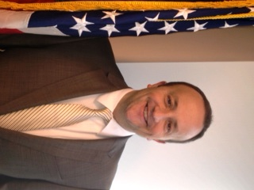
Today’s Presenters
Courtney Stevenson Transportation Specialist FMCSA
Bryan Price Transportation Specialist FMCSA

Slide 3
Today’s Objectives
Review the three primary objectives for the proposed Safety Measurement System (SMS) display changes and the associated enhancements reflected in this preview
Provide an overview of the SMS Preview Website
Outline timeline for the SMS Preview
Encourage participation in the public comment/preview feedback process

Slide 4
Today’s Agenda
Safety Measurement System (SMS) Improvement Process
Proposed SMS Display Changes
SMS Display Changes Preview Website and Timeline
Frequently Asked Questions (FAQs)

Slide 5
CSA’s Safety Measurement System (SMS)
Provides motor carriers and other safety stakeholders with more comprehensive, informative, and regularly updated safety performance data (see 75 FR 18256)
Quantifies the on-road safety performance and considers prior investigation findings of motor carriers to prioritize enforcement resources
Is used to determine the safety problems that a motor carrier may exhibit
Monitors whether a motor carrier’s safety problems are improving or worsening

Slide 6
SMS Improvement Process
SMS is designed to be continually improved over time based on:
Availability of better technology, new data, and additional analyses
Feedback from enforcement and other stakeholders, including industry
FMCSA will take a systematic approach to rolling out improvements (see 77 FR 18298)
Prioritize and package changes as needed
Provide public preview period prior to implementation

Slide 7
Why an SMS Preview?
Gives motor carriers and the public an opportunity to view and comment on changes, verify data, and educate drivers BEFORE the changes are implemented and become publicly available
Enables FMCSA to make final refinements to the package of changes BEFORE public release

Slide 8
Proposed SMS Display Changes Objectives
NOTE: The proposed SMS display changes do not modify or change the SMS methodology itself
Provide easier, more intuitive navigation and user-friendly features to clarify SMS’s role as a prioritization tool for CSA Interventions
Provide a “one-stop-shop” for FMCSA safety information
Retain and provide easy access to detailed information and improved performance monitoring tools

Slide 9
Proposed SMS Display Changes by Objective
Objective: Provide easier, more intuitive navigation and user-friendly features to clarify SMS’s role as a prioritization tool for CSA Interventions
Changes that meet this objective:
“Take a Tour” Feature ‒ highlights enhancements to the site, and shows visitors how to locate and use particular features
Overall Behavior Analysis and Safety Improvement Category (BASIC) Status − displays a summary BASIC status to better clarify if a carrier’s performance in the individual BASICs causes it to be prioritized for an intervention
Carrier’s Measure − provides a carrier’s measure, which only considers individual performance
Safety Event Groups − shows carrier safety event groups to clarify that the SMS is a relative system; makes safety event group lists available for download

Slide 10
Proposed SMS Display Changes by Objective
Objective: Provide a “one-stop-shop” for FMCSA safety information
Changes that meet this objective:
Safety Rating − displays a carrier’s safety rating from a compliance review issued in accordance with 49 CFR Part 385 (updated daily)
Licensing and Insurance − provides a carrier’s current insurance and authority status (updated hourly)
Penalties History − shows a carrier’s enforcement history including the date the case was closed, the applicable violations, and the associated fines (updated daily)

Slide 11
Proposed SMS Display Changes by Objective
Objective: Retain and provide easy access to detailed information and improved performance monitoring tools
Changes that meet this objective:
Improved Graphs – present data in a variety of customizable displays to enhance users’ understanding of safety performance over time
Inspection History − shows the total number of inspections for each carrier, as well as a breakdown of the number of inspections with and without violations

Slide 12
SMS Display Changes Preview Website

Slide 13
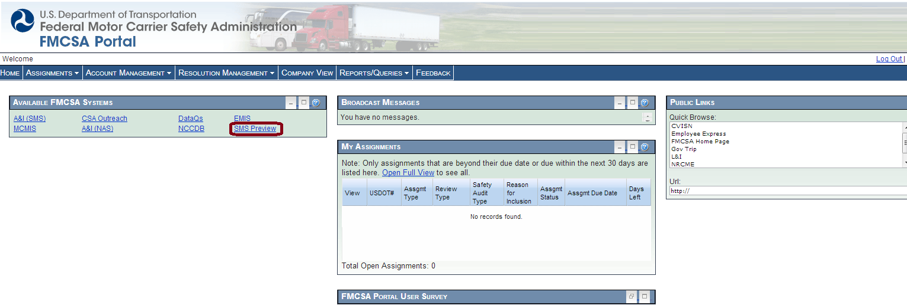
Accessing the SMS Preview – Carriers
Notes:
13

Slide 14
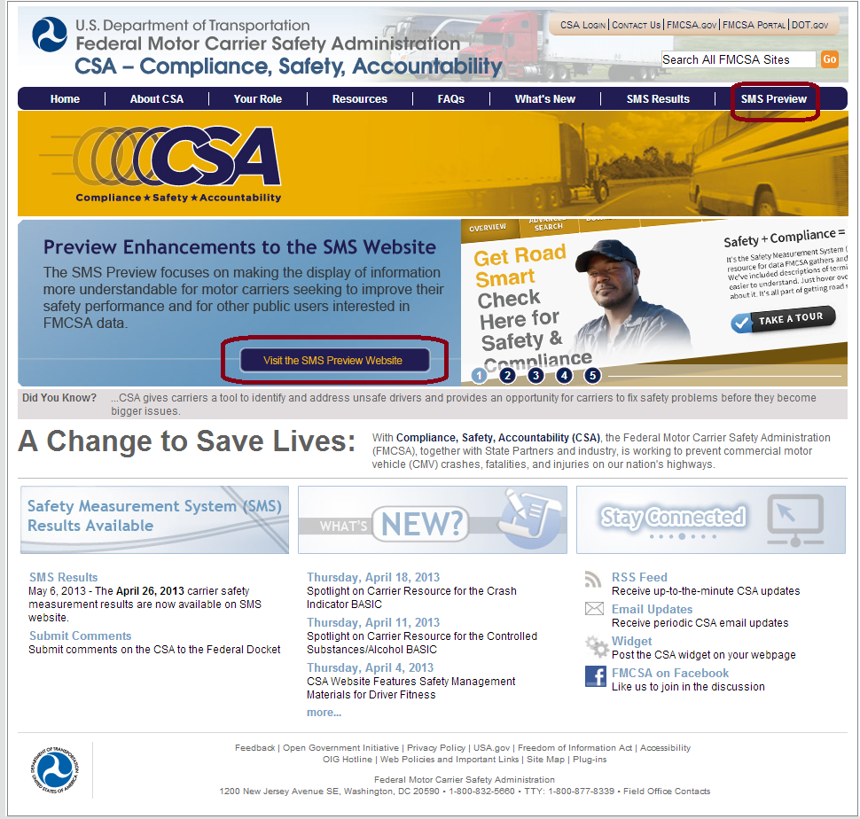
Accessing the SMS Preview – Public

Slide 15
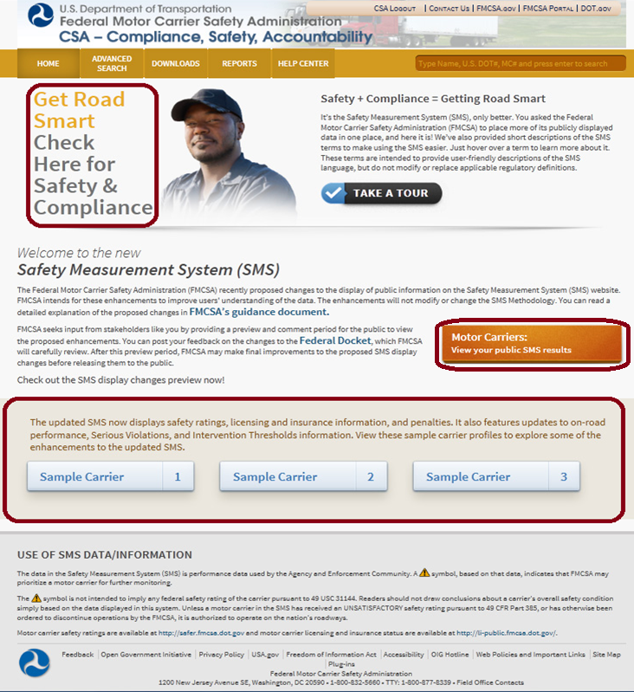
SMS Preview Homepage
Introduce the Get Road Smart campaign
Choose from three sample carriers to explore the SMS display changes (available to the public)

Slide 16
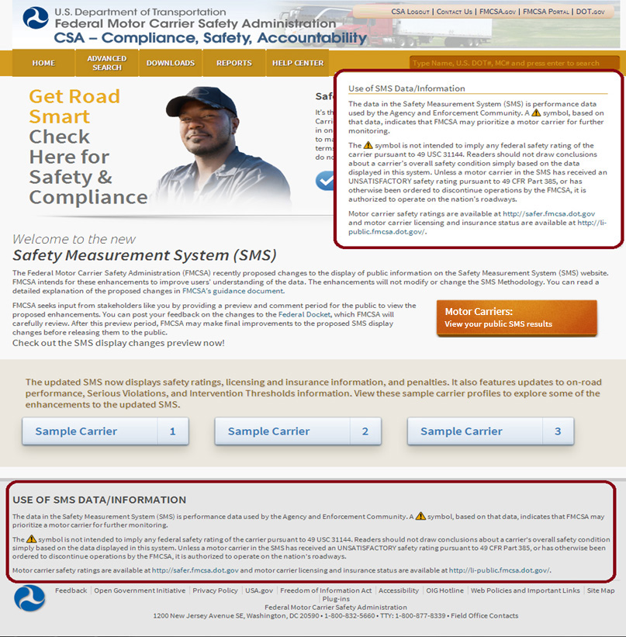
Disclaimer
Appears at the bottom of every web page and pops up every time the search box is used
Has not been modified

Slide 17
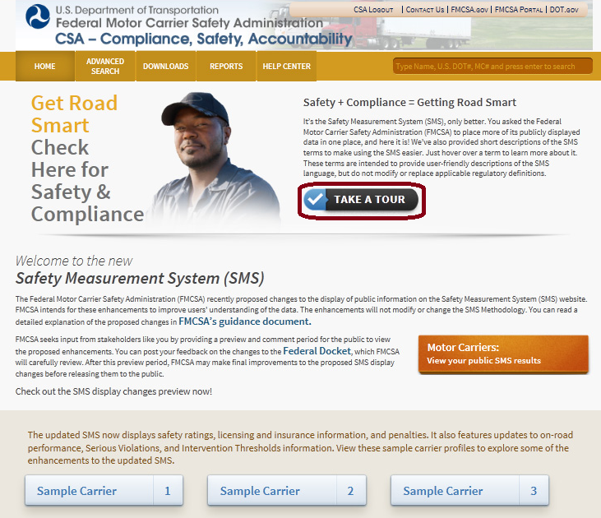
“Take a Tour” Feature
Objective: Clarify SMS’s role as a prioritization tool for CSA Interventions
Select to see how to locate and use particular enhancements to the SMS Website

Slide 18
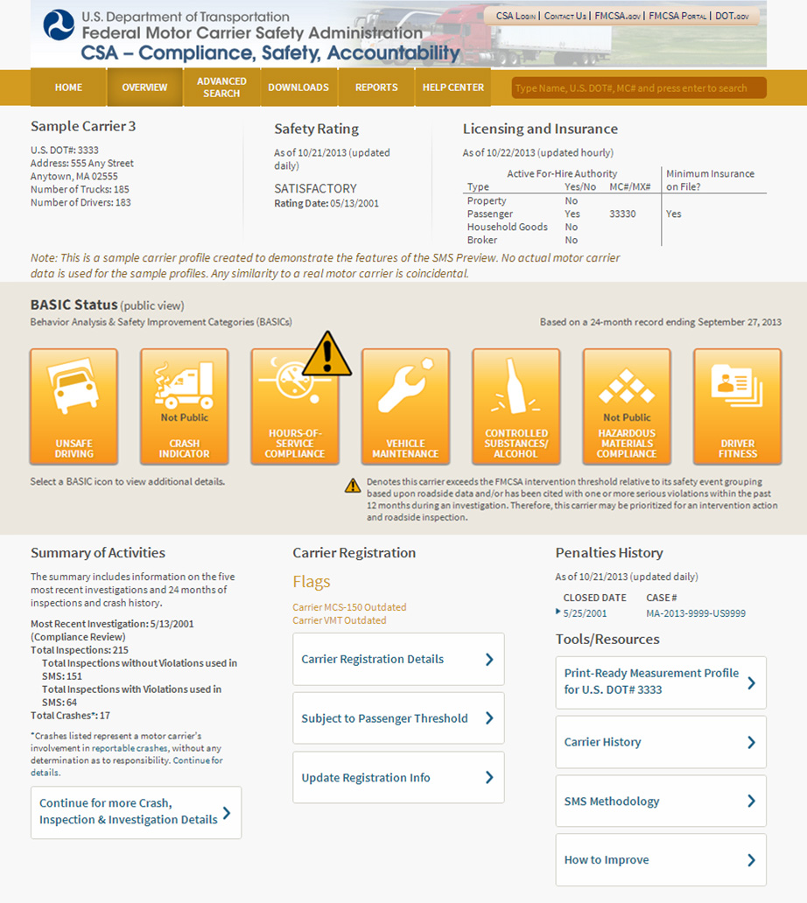

Slide 19
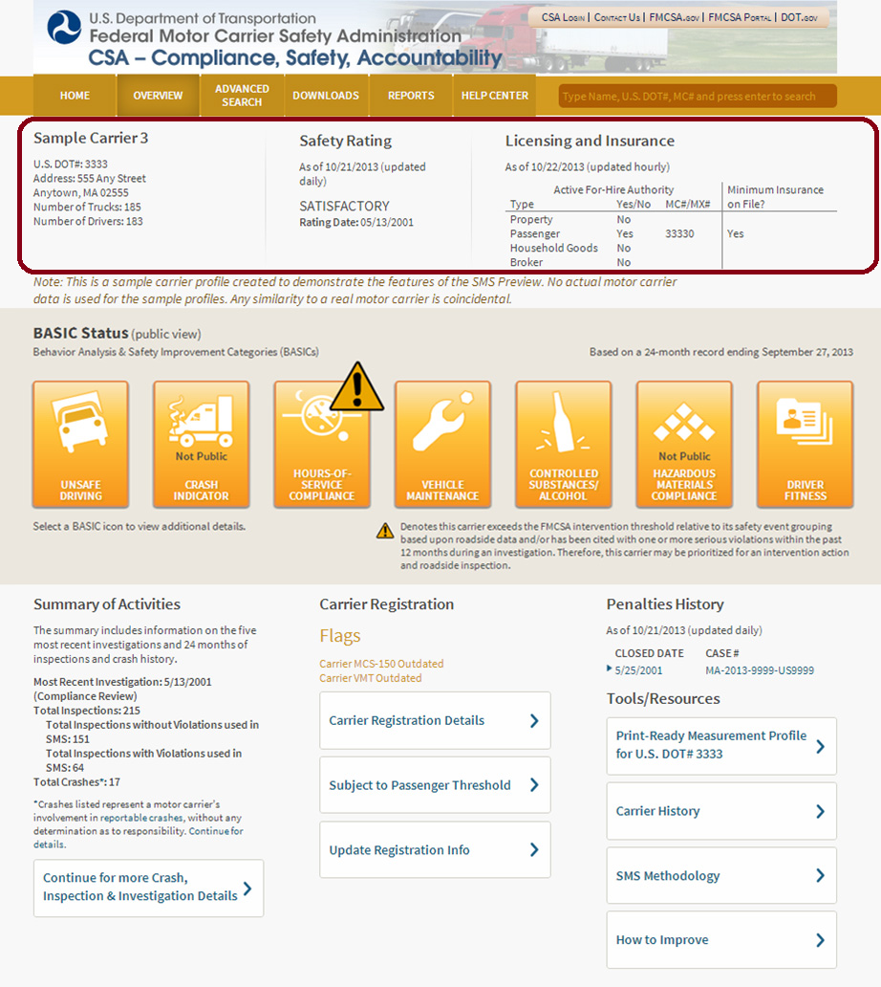
Safety Rating and Licensing and Insurance
Objective: Provide a “one-stop-shop” for FMCSA safety information

Slide 20
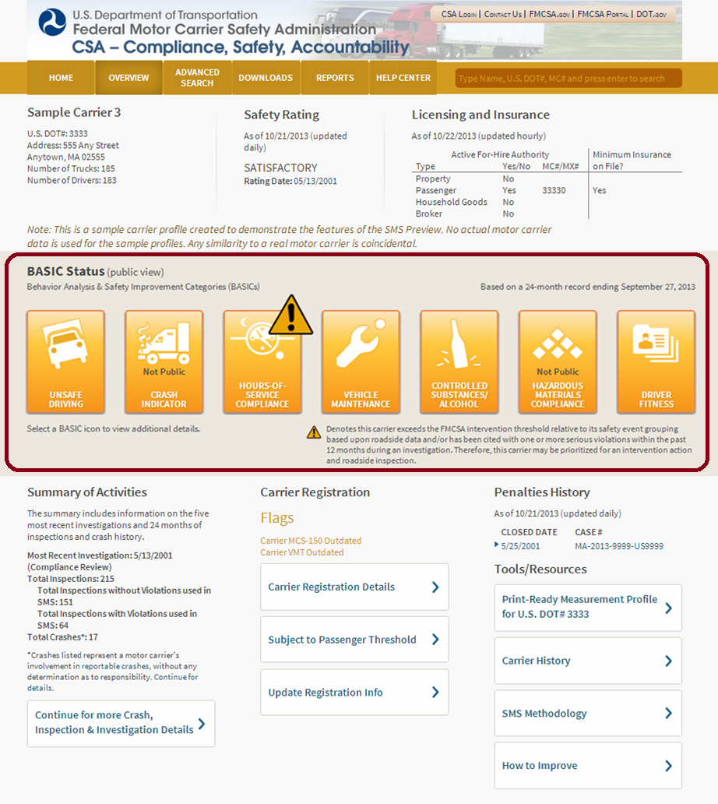
Overall BASIC Status
Shows overall BASIC in status, i.e., whether a BASIC has been prioritized for intervention
BASIC percentile data has been retained and is available on the BASIC Detail page

Slide 21
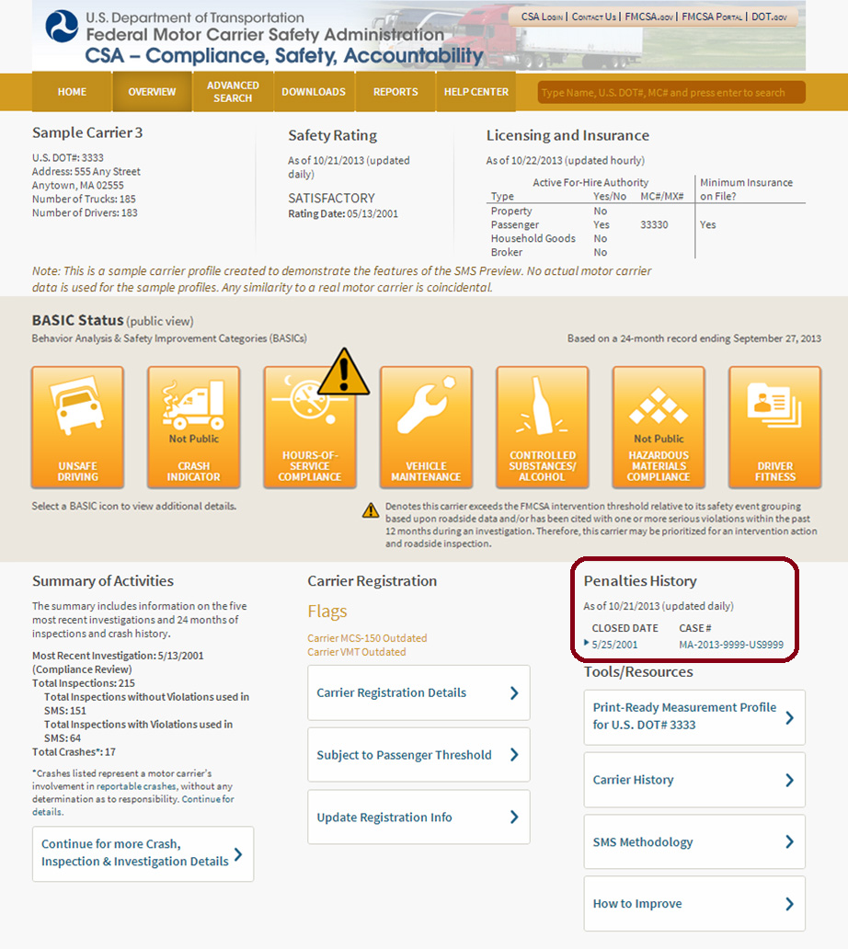
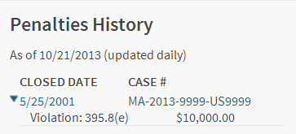
Penalties History
Objective: Provide a “one-stop-shop” for FMCSA safety information

Slide 22
Accessing the BASIC Detail Page

Slide 23
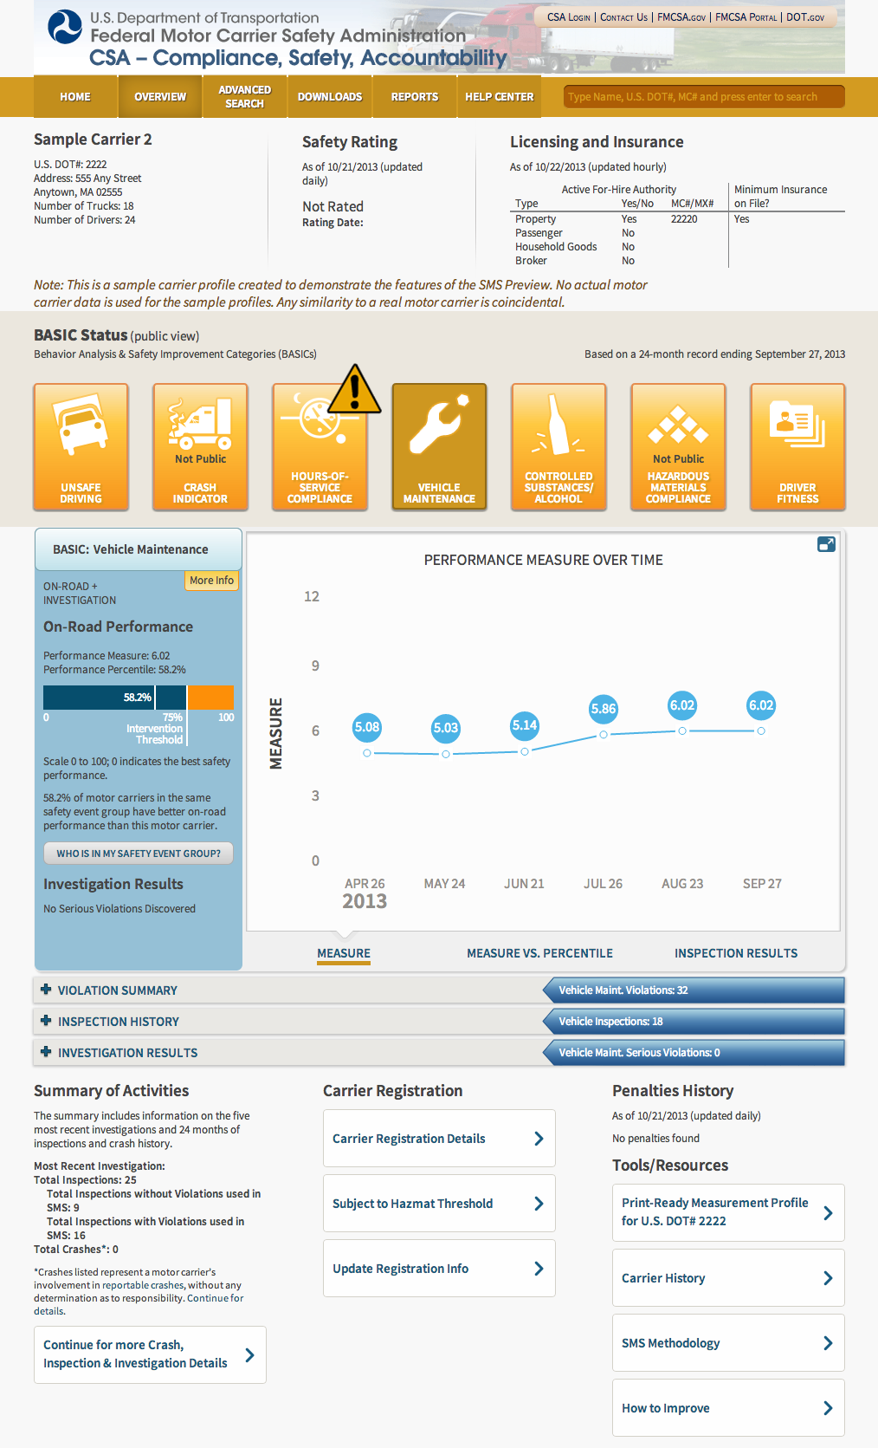

Slide 24
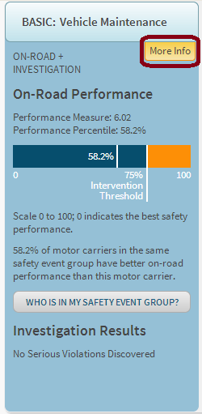
Measure, Safety Event Group, and Intervention Threshold
The new BASIC Detail page:
Highlights a carrier’s measure
Displays an Intervention Threshold graphic that shows the carrier’s performance percentile in relation to the Intervention Threshold in that BASIC
Includes a link to download all of the carriers in the same safety event group used to rank a carrier’s BASIC percentile
Displays investigation results, i.e., whether Serious Violations have been discovered (12 months’ worth)

Slide 25
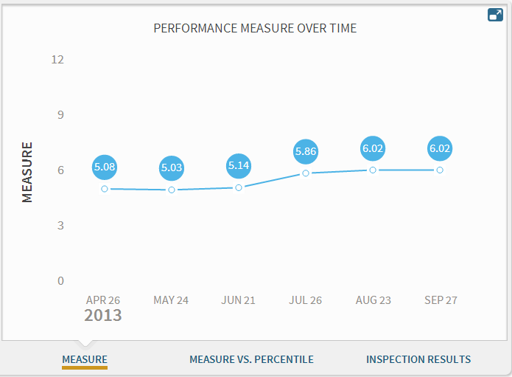
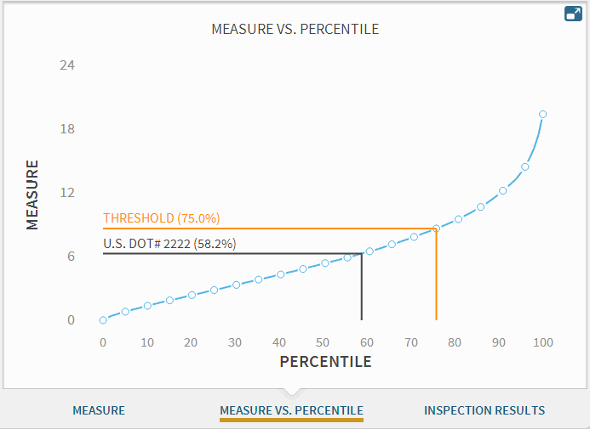
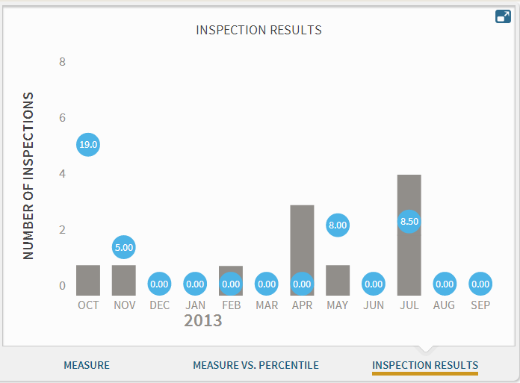
Improved Graphs
Objective: Retain and provide easy access to detailed information and improved performance monitoring tools

Slide 26
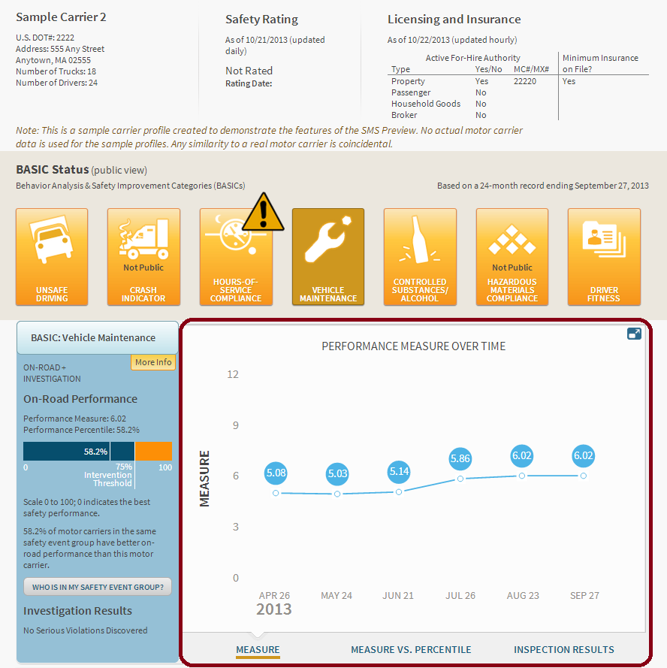
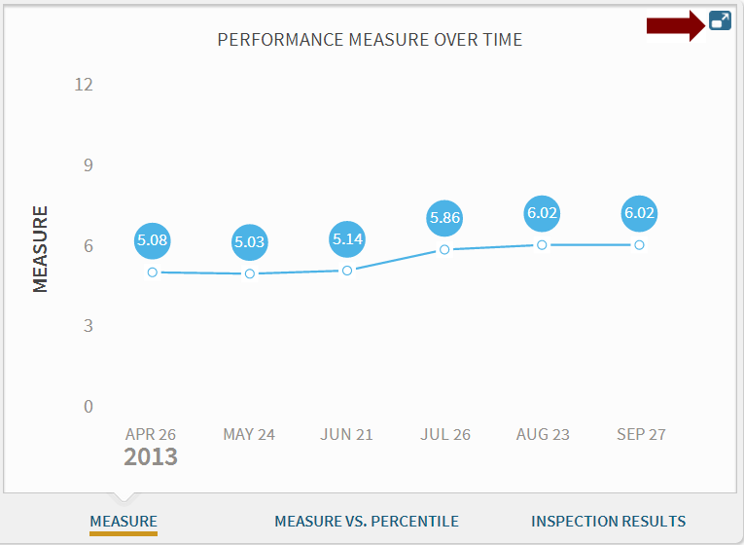
Measure Graph
Click to expand and customize the view of this graph

Slide 27
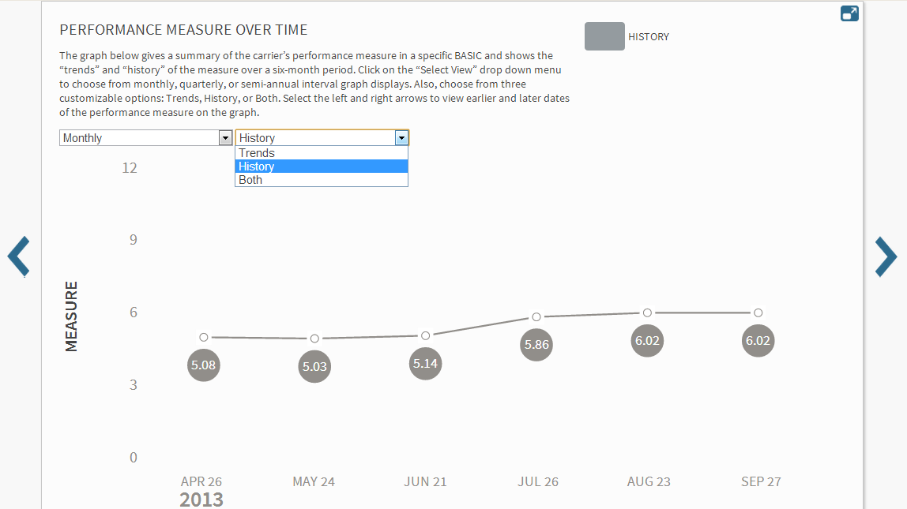
Measure Graph (Detail View)
Click to make graph smaller

Slide 28
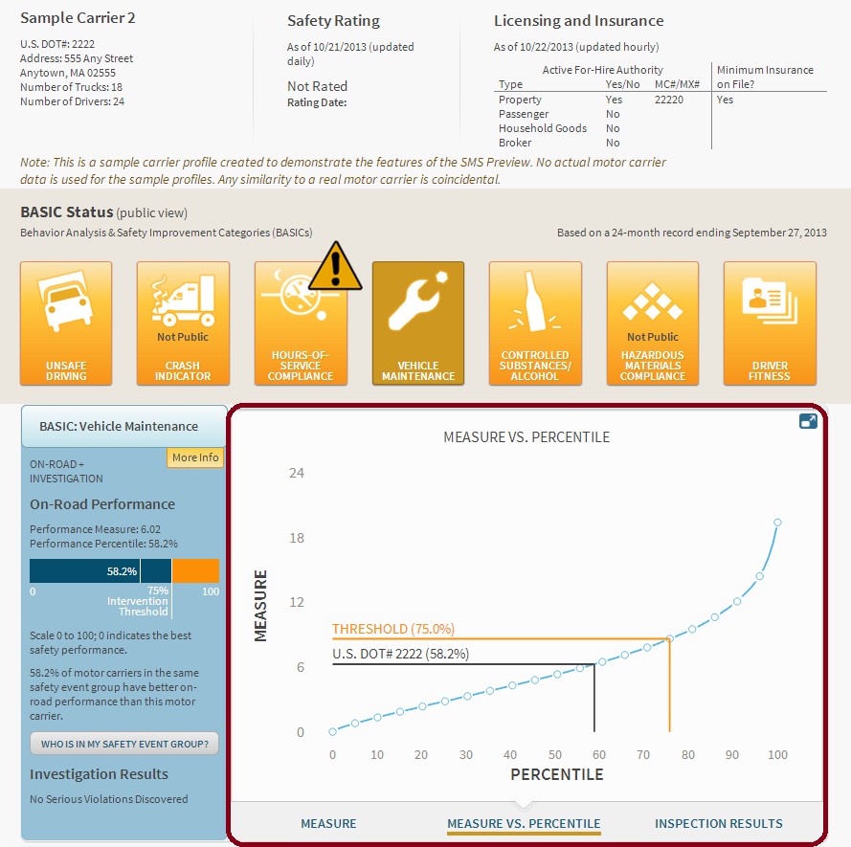
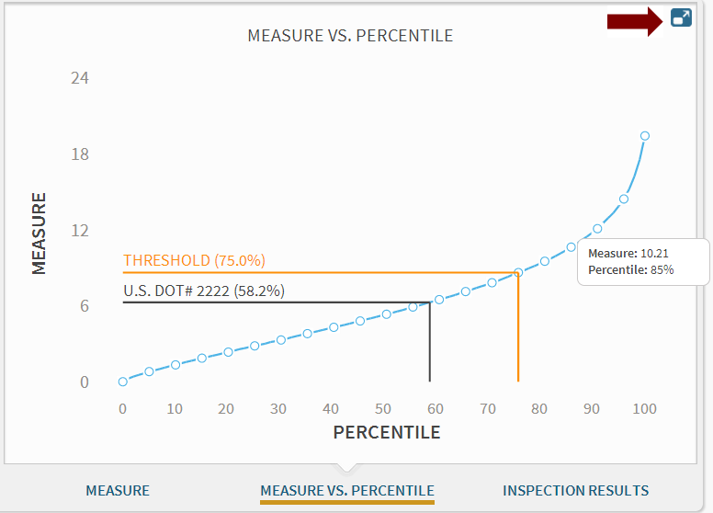
Measure vs. Percentile Graph
Click to expand graph

Slide 29
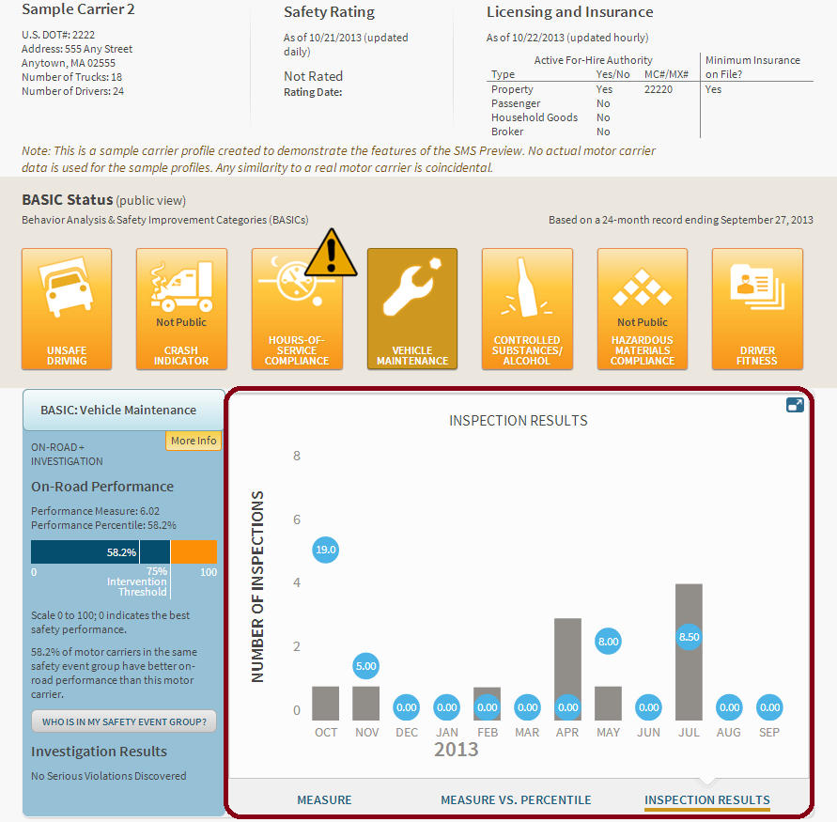
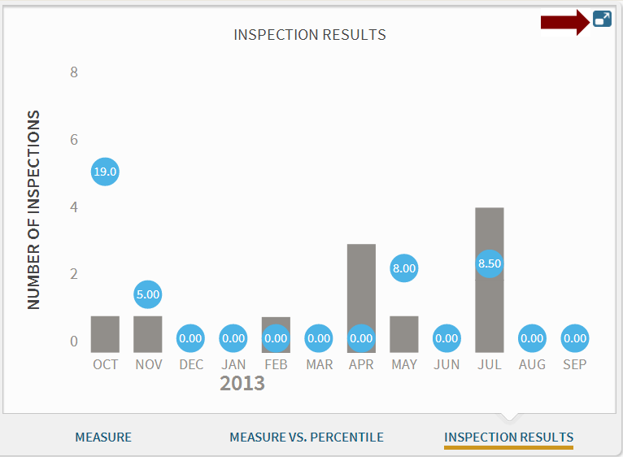
Inspection Results Graph
Click to expand and customize the view of this graph

Slide 30
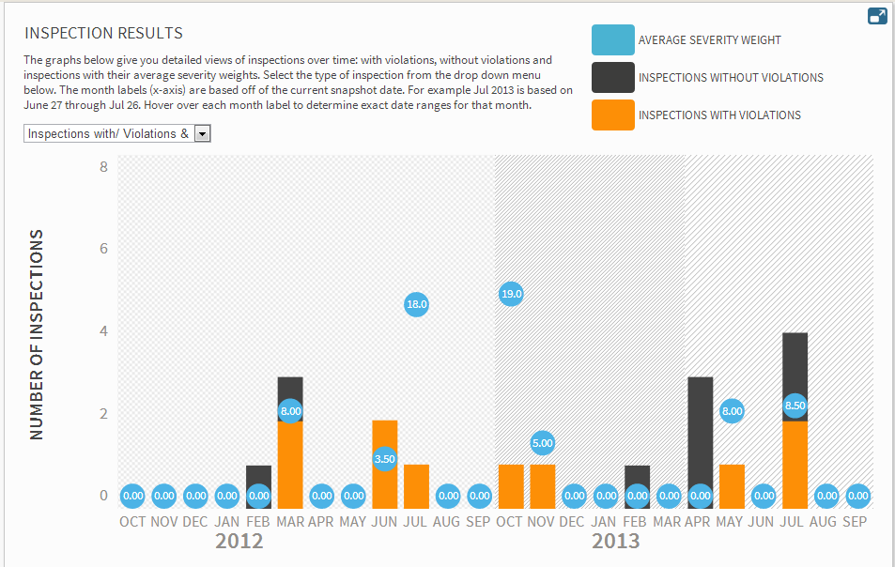
Inspection Results Graph (Detail View)
Click to make graph smaller

Slide 31
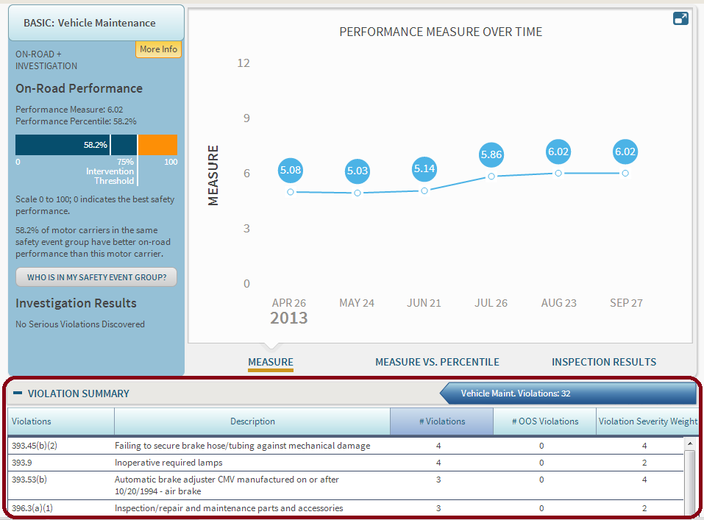
Violation Summary

Slide 32
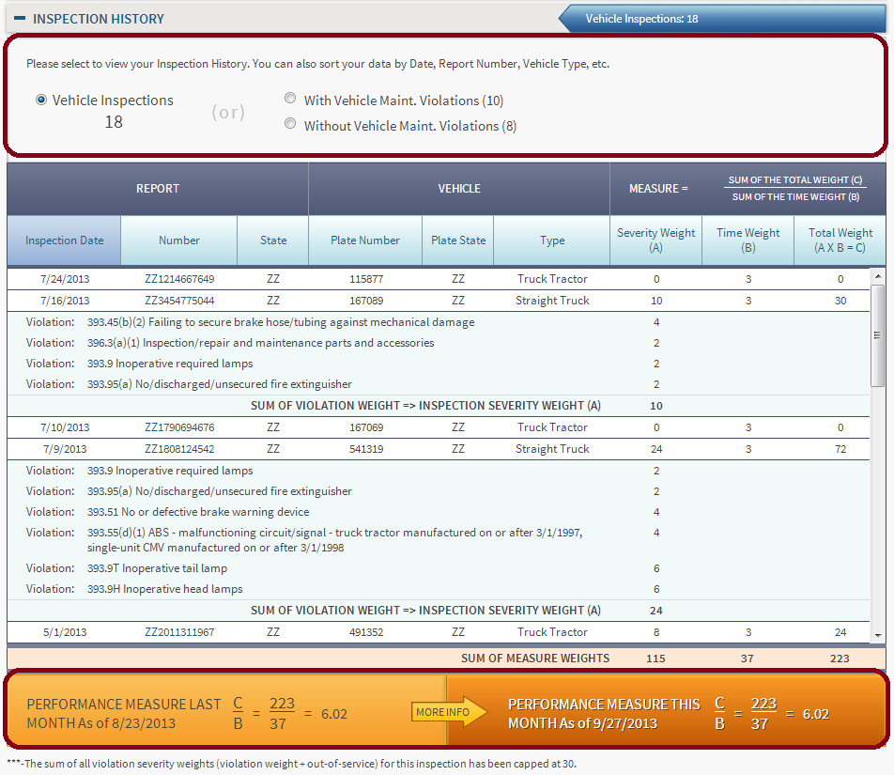
Inspection History
Objective: Retain and provide easy access to detailed information and improved performance monitoring tools

Slide 33
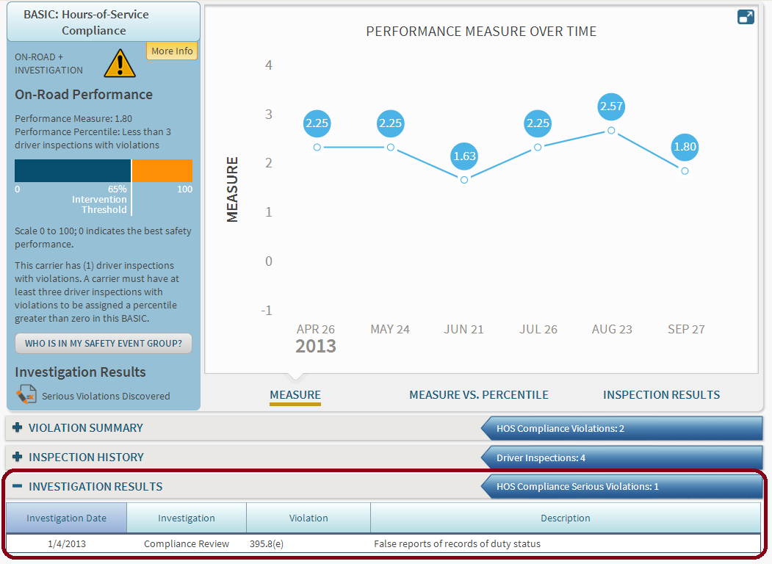
Investigation Results

Slide 34
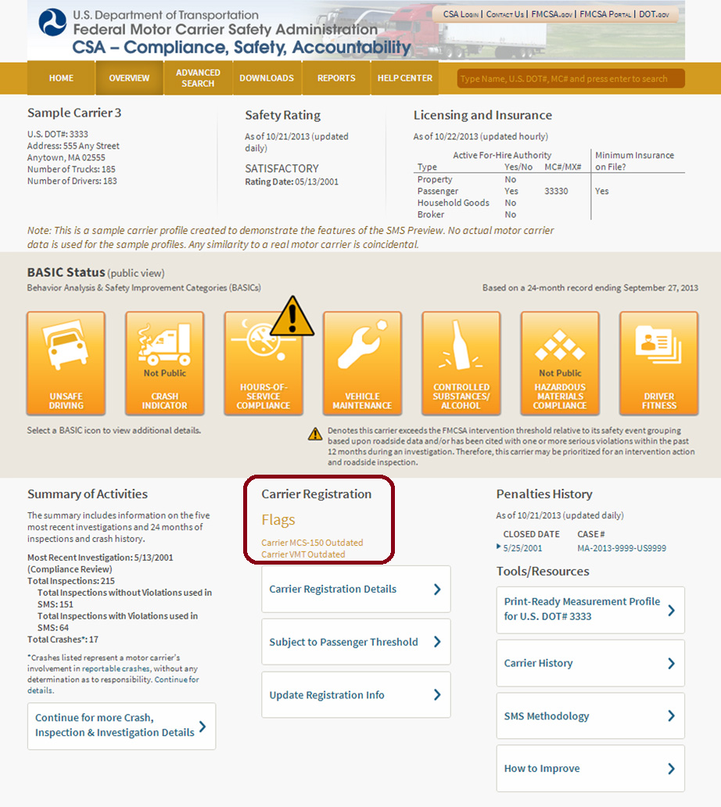
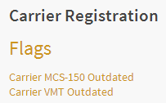
Carrier Registration
Includes “Carrier MCS-150 Outdated” flag based on the carrier’s MCS-150 not being updated in the last 24 months
Includes “Carrier VMT Outdated” flag based on the carrier’s Vehicle Miles Traveled field not reflecting data from one of two previous years
Carriers can click “Update Registration Info” to update their registration information

Slide 35
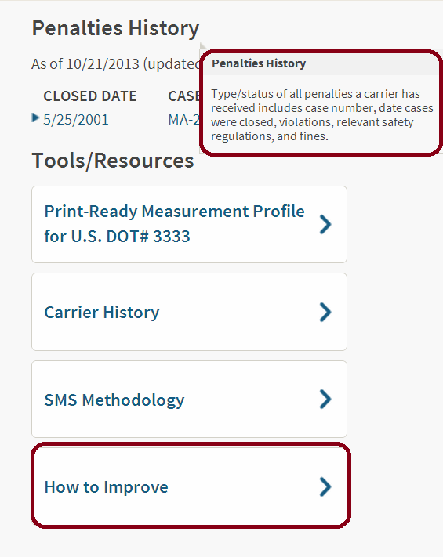
SMS Display Key Terms and Tools/Resources
Hover over key terms to view their definitions or visit the Help Center to download the “SMS Display Key Terms” glossary
Click “How to Improve” to view the “Take a Tour” feature, SMS Preview FAQs, and information on how to improve in each BASIC

Slide 36
SMS Display Changes Preview Timeline
November 5 (Public Preview)
60-day comment period began with the publication of the Federal Register Notice
Winter 2013/Spring 2014 (Planned Timeframe)
SMS public website will be updated with the SMS display changes

Slide 37
FAQs

Slide 38
Question: What will motor carriers and the public be able to view on the SMS Preview Website?
Answer: The preview of the SMS display changes is designed to present the safety data that would be available to the public. Therefore, motor carriers and the public will be able to view safety information except for the Crash Indicator and HM Compliance BASICs, which are not available to the public.

Slide 39
Question: Why is FMCSA proposing these changes to the SMS display?
Answer: FMCSA is committed to transparency and to ensuring that its safety data is easily understood and accessible to a variety of stakeholders. As part of this commitment, the Agency is proposing these changes to address feedback from stakeholders on how to better leverage the SMS Website to promote safety.

Slide 40
Question: Does the SMS Preview include changes to the SMS methodology?
Answer: No. This SMS Preview is focused on the display of information on the SMS Website and does not make changes to the methodology itself. These display changes are designed to address feedback from stakeholders who want to better understand the SMS and its relationship to other FMCSA-issued safety data.

Slide 41
Question: Is FMCSA considering making changes to the SMS methodology?
Answer: Yes, FMCSA is currently considering making changes to the SMS methodology. Items on the Agency’s radar include:
Utilization factor
Severity weights
Hazardous Materials (HM) Compliance BASIC
Safety event groups
The Agency will apply the same systematic approach used for this SMS Preview to make improvements to the methodology.

Slide 42
Question: What should motor carriers and the public do during the preview of the SMS display changes?
Answer: During the SMS Preview, motor carriers and the public should:
Submit comments on the proposed SMS display changes via the Federal Docket, for instructions check out the Federal Register Notice (https://www.federalregister.gov/agencies/federal-motor-carrier-safety-administration)
Try out the new “Take a Tour” feature, which shows you how to locate and use particular enhancements to the site
View all of the safety information available on the new Carrier Overview and BASIC Detail pages
Visit the Help Center to download the “SMS Display Key Terms” glossary or hover over SMS display terms throughout the Preview website to view their definitions

Slide 43
Question: What other CSA-related initiatives are underway?
Answer: FMCSA has a number of CSA-related initiatives that are underway, including:
Crash Weighting Report
Adjudicated citations
CSA Effectiveness Report
SMS Effectiveness Report
Safety Fitness Determination Notice of Proposed Rulemaking

Slide 44
For Additional Support and to Provide Comments
Visit the CSA Website for FAQs searchable by key word
Review the SMS Display Changes Guidance Document
Ask questions via the CSA Website at http://csa.fmcsa.dot.gov/CSA_Feedback.aspx or call 877-254-5365
Submit comments and feedback via the Docket at http://www.regulations.gov

