Slide 1
SMS Display Enhancements and New Adjudicated Citations Policy
The Safety Measurement System (SMS) Display Enhancements and
New Adjudicated Citations Policy
Industry Briefing
Summer 2014
Federal Motor Carrier Safety Administration (FMCSA)

Slide 2

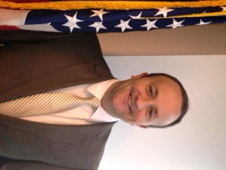
Today’s Presenters
Courtney Stevenson
Transportation Specialist
FMCSA
Bryan Price
Transportation Specialist
FMCSA

Slide 3
Today’s Agenda
Review Compliance, Safety, Accountability’s (CSA) Safety Measurement System (SMS) and its improvement process.
Outline primary objectives for SMS display enhancements.
Provide an overview of SMS display enhancements.
Outline new adjudicated citations policy.
Q&A on topics covered.

Slide 4
CSA’s Safety Measurement System (SMS)
Provides motor carriers and other safety stakeholders with more comprehensive, informative, and regularly updated safety performance data (see 75 FR 18256).
  Quantifies the on-road safety performance and considers prior investigation findings of motor carriers to prioritize enforcement resources.
  Helps determine the safety problems a motor carrier is exhibiting.
  Monitors motor carriers’ safety problems for improvement or interventions.

Slide 5
SMS Improvement Process
SMS continually improved based on:
  Availability of better technology, new data, and additional analyses.
  Feedback from enforcement and other stakeholders, including industry.
FMCSA applies a systematic approach to implementing improvements (see 77 FR 18298).
  Prioritize and package changes as needed.
  Provide public preview period prior to implementation of major changes.

Slide 6
SMS Display Enhancements Timeline
Fall 2013
Spring 2014
Winter 2012‒
Spring 2013
Began development of proposed display changes based on feedback from stakeholders, including MCSAC’s CSA subcommittee.
Reviewed and considered all stakeholder feedback from preview.
Summer 2014
Released enhanced SMS Website.
Made final improvements.
Held industry webinars.
Began public preview and comment period.
Announced display enhancements in July 24, 2014 FR Notice.

Slide 7
SMS Display Enhancements Objectives
Provide easier, more intuitive navigation and user-friendly features to clarify SMS’s role as a prioritization tool for FMCSA interventions.
Consolidate FMCSA safety information so users do not have to go to multiple sites.
Retain and provide easy access to detailed information and improved performance monitoring tools.
NOTE: The SMS display changes do not modify or change the SMS methodology or affect a carrier’s safety rating, which is subject to the Safety Fitness Procedures at 49 CFR Part 385.

Slide 8
Objective 1: Easier, Intuitive, User-friendly Features to Clarify SMS’s Role as Prioritization Tool for FMCSA Interventions
Overall Behavior Analysis and Safety Improvement Category (BASIC) Status − displays a summary of a carrier’s status in each BASIC.
“Take a Tour” ‒ highlights site enhancements; shows visitors how to locate and use particular features.
Safety Event Groups − shows carrier safety event groups to clarify that the SMS is a relative system; makes safety event group lists available for download.
Reordered BASICs – reordered based on their association to crash rate; BASICs with the strongest associations are to the left.
BASIC Status to Crash Rate Graphs * – acknowledge distinctions between BASICs and crash involvement, based on findings from the SMS Effectiveness Test that FMCSA conducted.

Slide 9
Objective 2: Consolidate FMCSA Safety Information So Users Do Not Have to Go to Multiple Sites
Safety Rating − displays a carrier’s safety rating from a compliance review issued in accordance with 49 CFR Part 385 (updated daily).
Licensing and Insurance − provides a carrier’s current insurance and authority status (updated hourly).
Penalties History − shows a carrier’s enforcement history including the date the case was closed, applicable violations, and associated fines (updated daily).
Inspection Selection System (ISS) * − allows a logged-in carrier to access its own ISS information.
Out-of-Service (OOS) Rates * ‒ provides carrier and driver OOS rates and national averages.
Doing Business As (DBA) Name * − shows a carrier’s DBA name to enhance the search options on the website.

Slide 10
Objective 3: Easy Access to Detailed Information and Improved Performance Monitoring Tools
Carrier’s Measure − highlights a carrier’s measure in each BASIC to more clearly identify its performance trends over time.
Improved Graphs – present data in a variety of customizable displays to enhance users’ understanding of safety performance over time.
Inspection History − shows total number of inspections for each carrier, as well as a breakdown of the number of inspections with and without violations.

Slide 11
Enhanced SMS Website

Slide 12
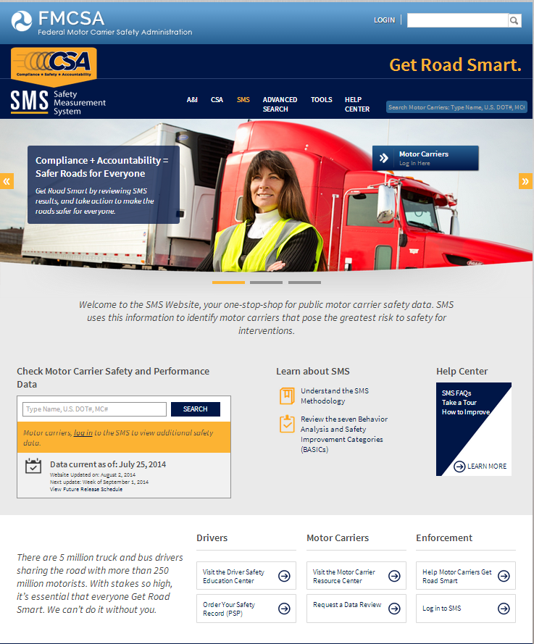

Slide 13
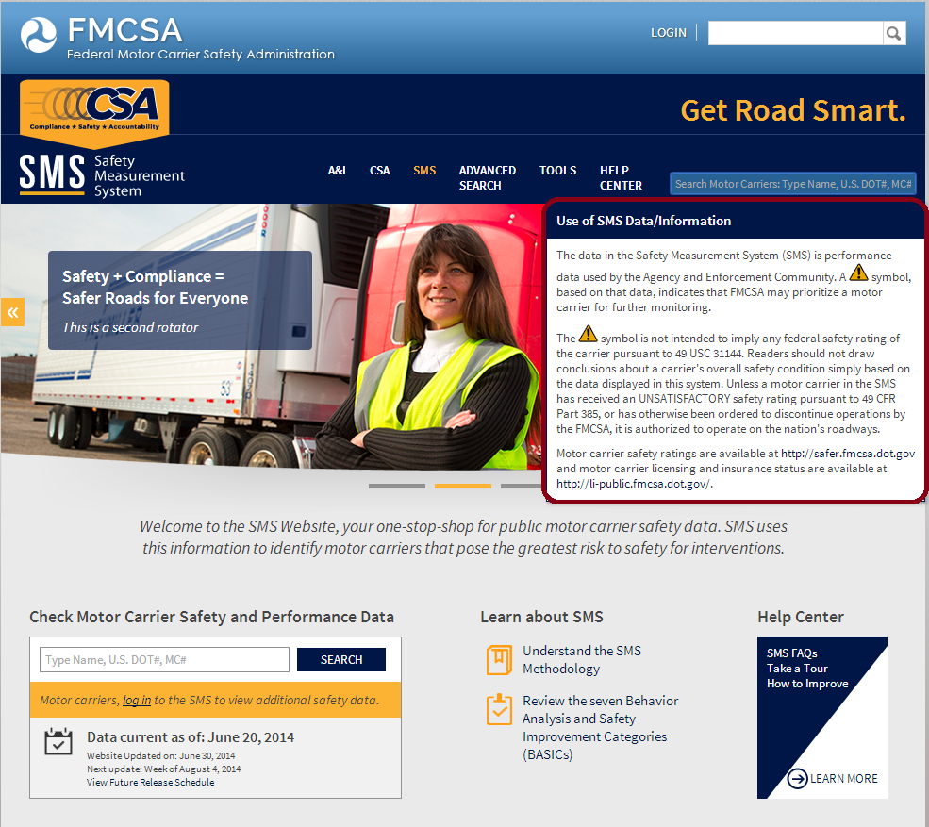
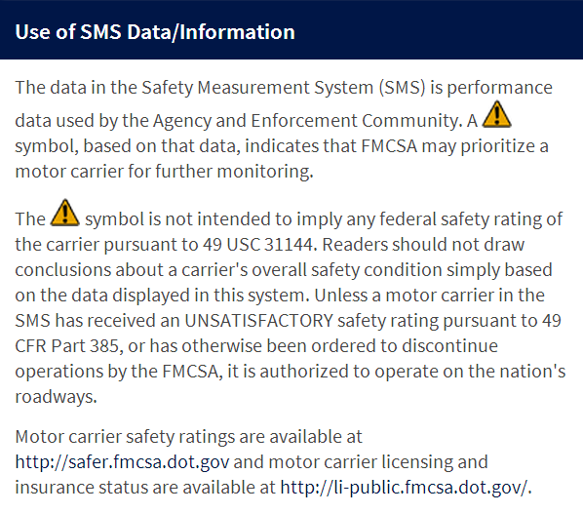

Slide 14
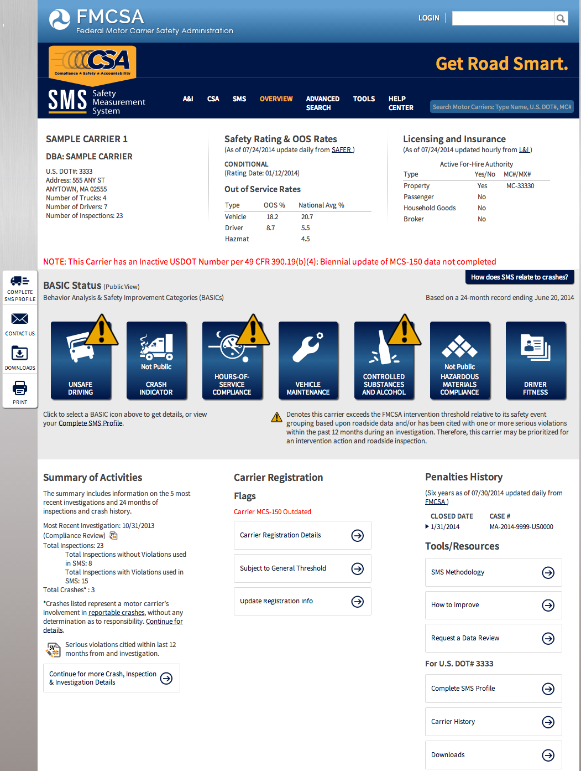

Slide 15
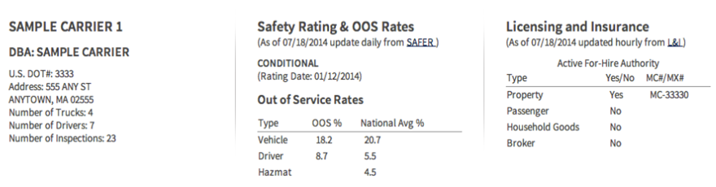
DBA Name, Safety Rating, OOS Rates, and Licensing and Insurance

Slide 16
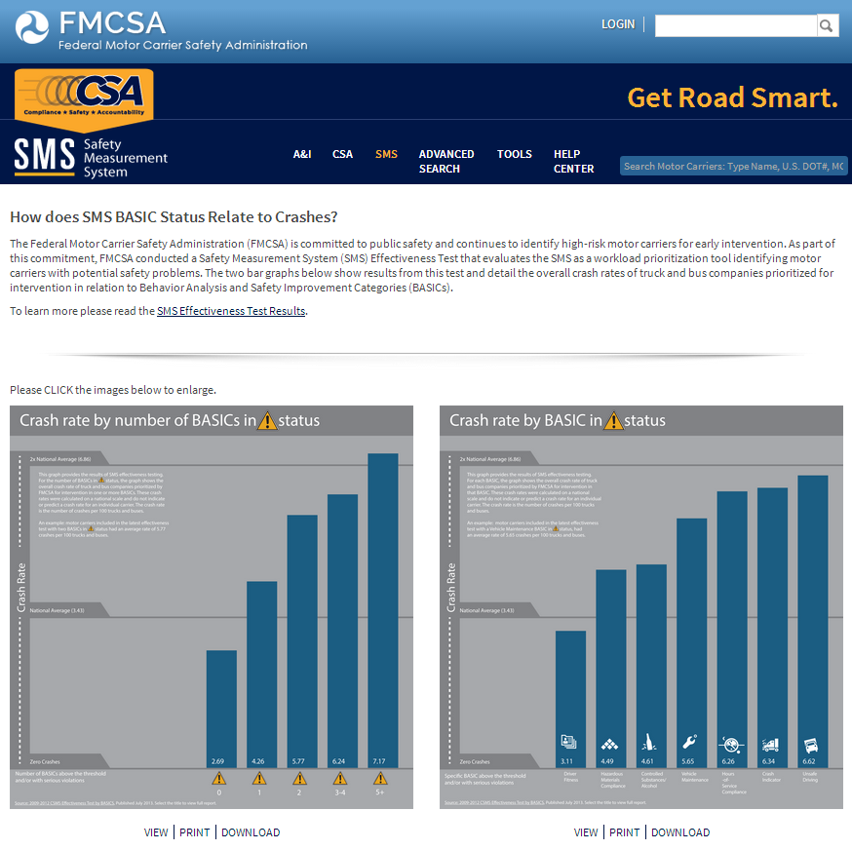
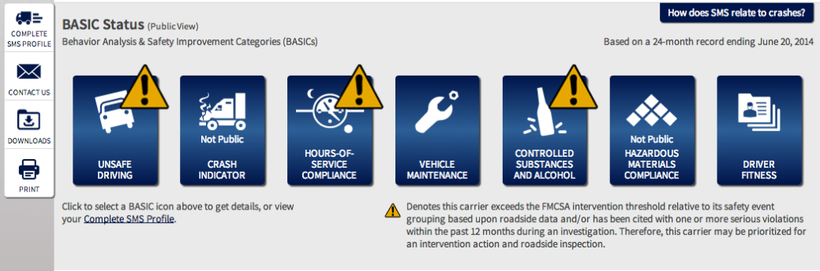
BASIC Status to Crash Rate Graphs
Click “How does SMS relate to crashes?” to get to the BASIC Status to Crash Rate graphs

Slide 17
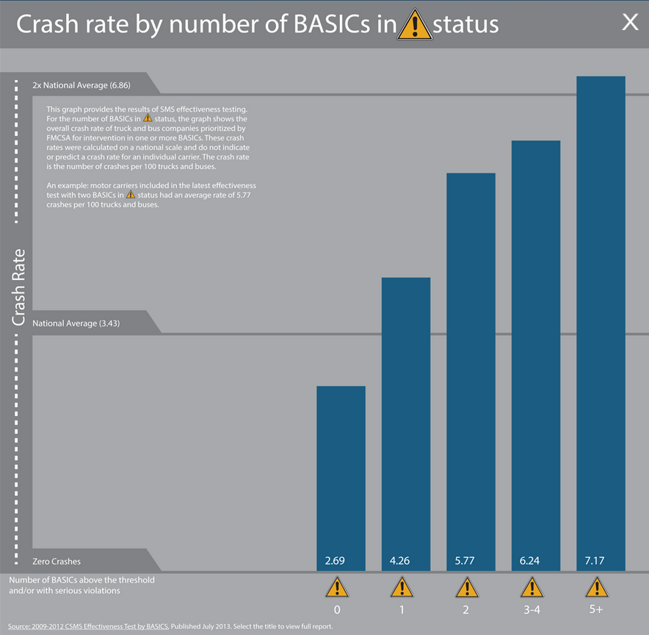

Slide 18
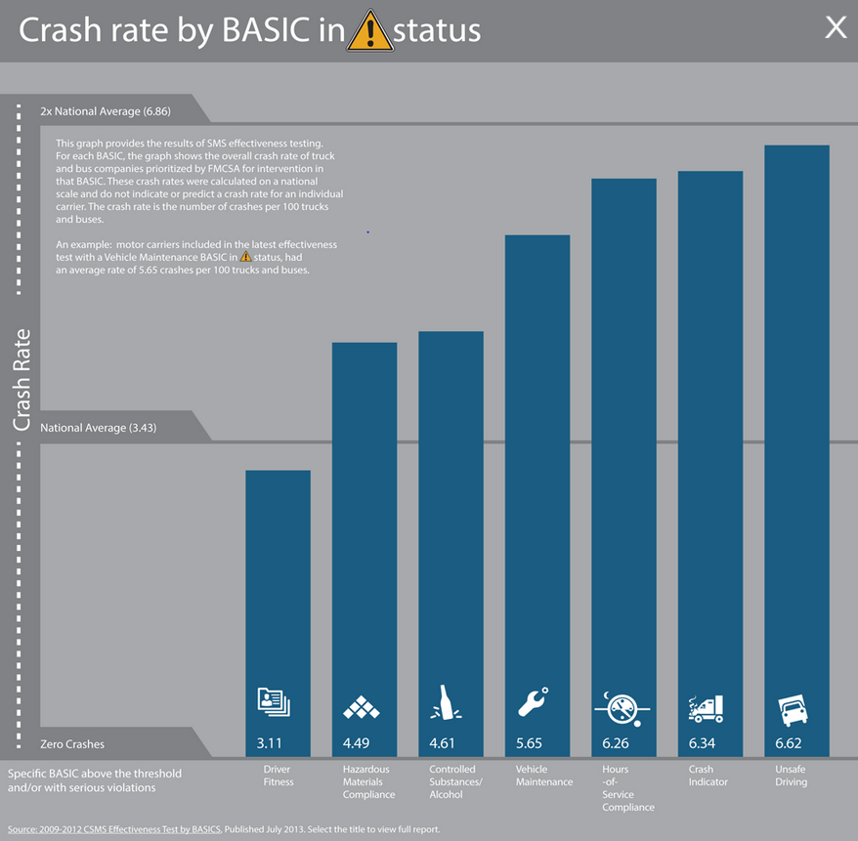

Slide 19
Overall BASIC Status/Complete SMS Profile
Shows overall BASIC in status, i.e., whether a BASIC has been prioritized for interventions or further monitoring.
BASIC percentile data is retained and available on the BASIC Detail page.
Select “Complete SMS Profile” to view a carrier’s full SMS results.

Slide 20
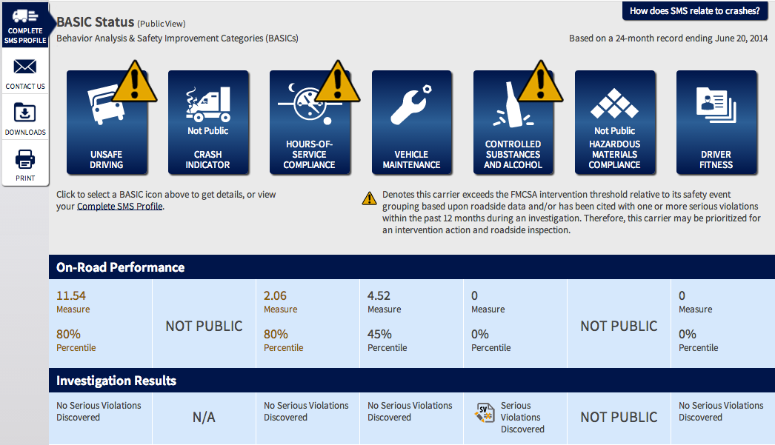
Complete SMS Profile

Slide 21
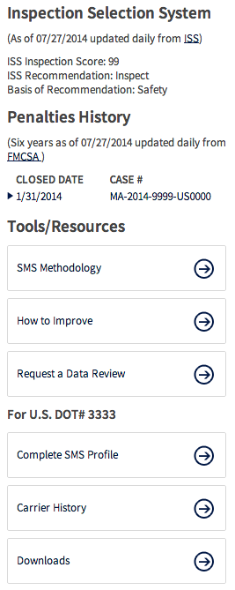
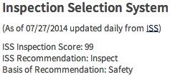
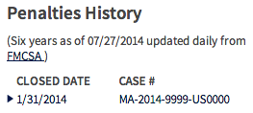
ISS Information, Penalties History, and Tools/Resources

Slide 22
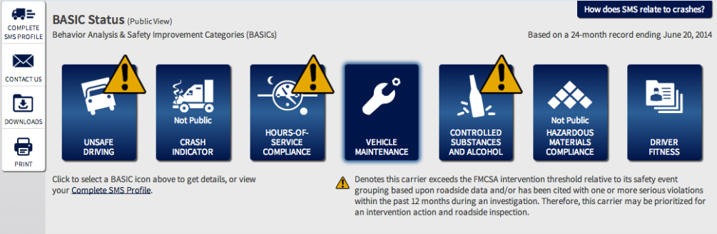
Accessing the BASIC Detail Page

Slide 23
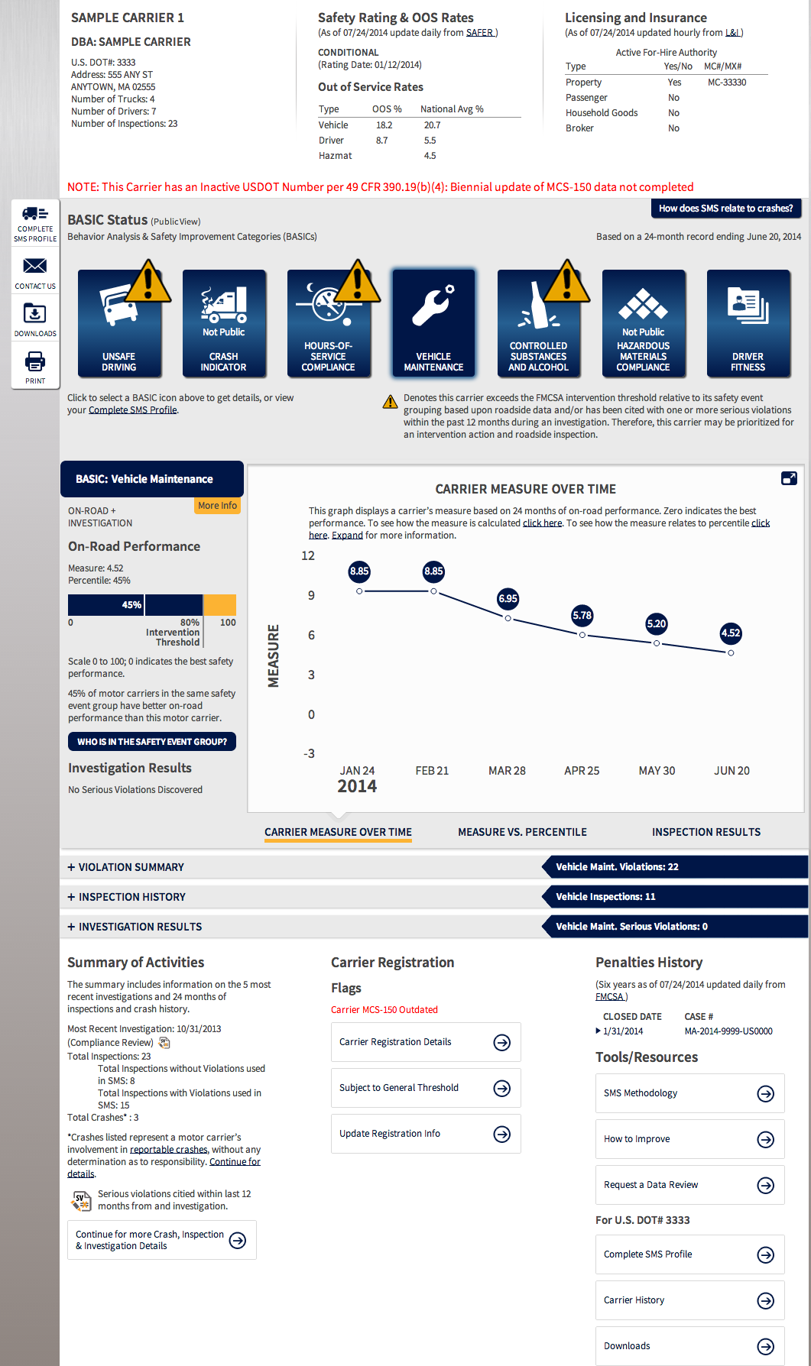

Slide 24
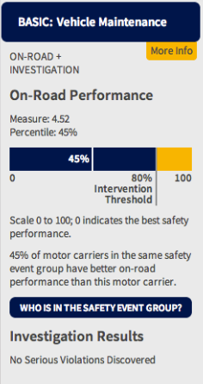
Measure, Intervention Threshold, Safety Event Group
Highlights a carrier’s measure.
Displays an Intervention Threshold graphic showing the carrier’s percentile in relation to the Intervention Threshold in that BASIC.
Includes a “Who Is In the Safety Event Group?” link to download all of the carriers in the same safety event group used to rank a carrier’s BASIC percentile.
Displays investigation results, i.e., whether Serious Violations have been discovered within the past 12 months.

Slide 25
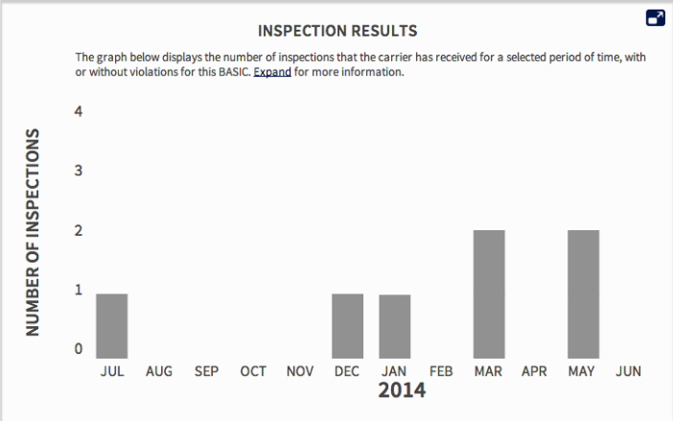
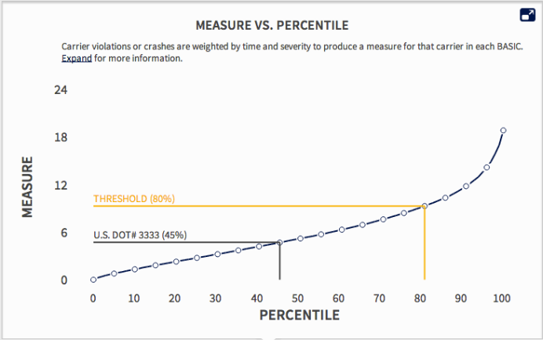
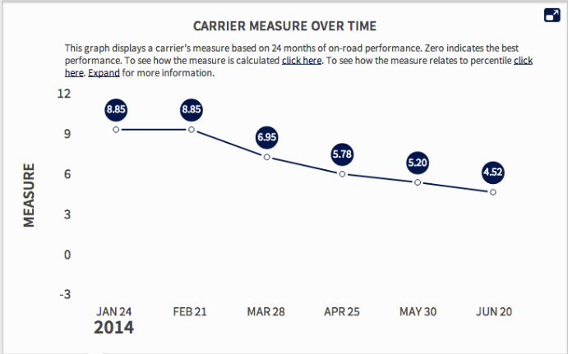
Improved Graphs

Slide 26
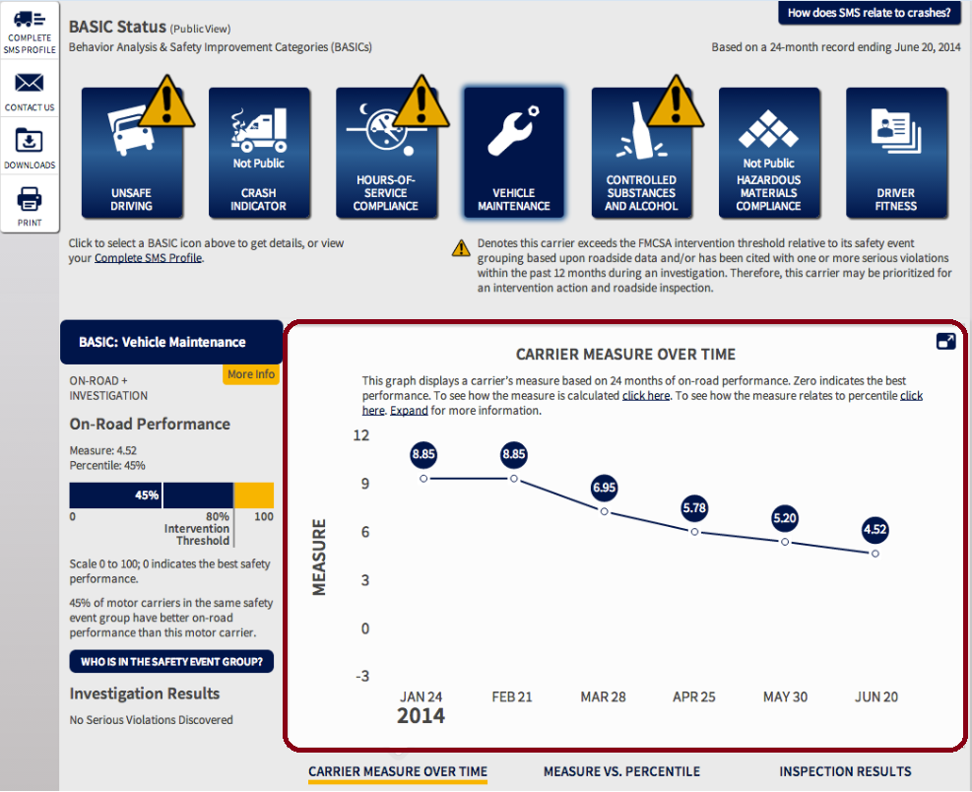
Carrier Measure Over Time Graph
Click to expand and customize the view of this graph

Slide 27
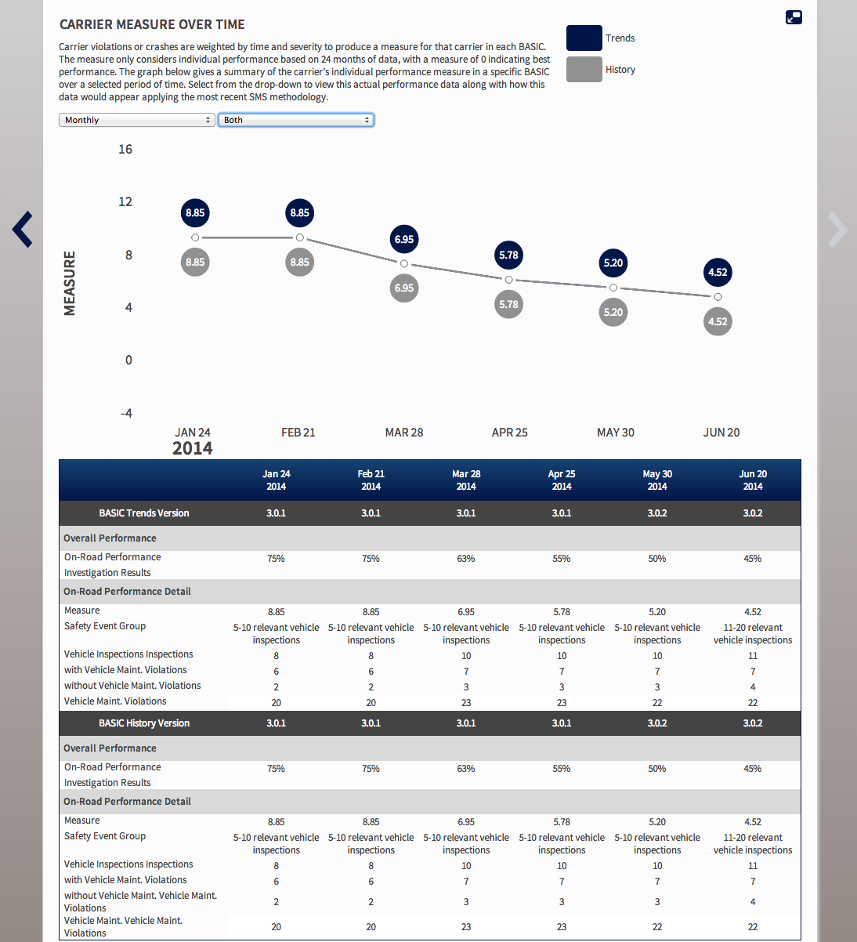

Slide 28
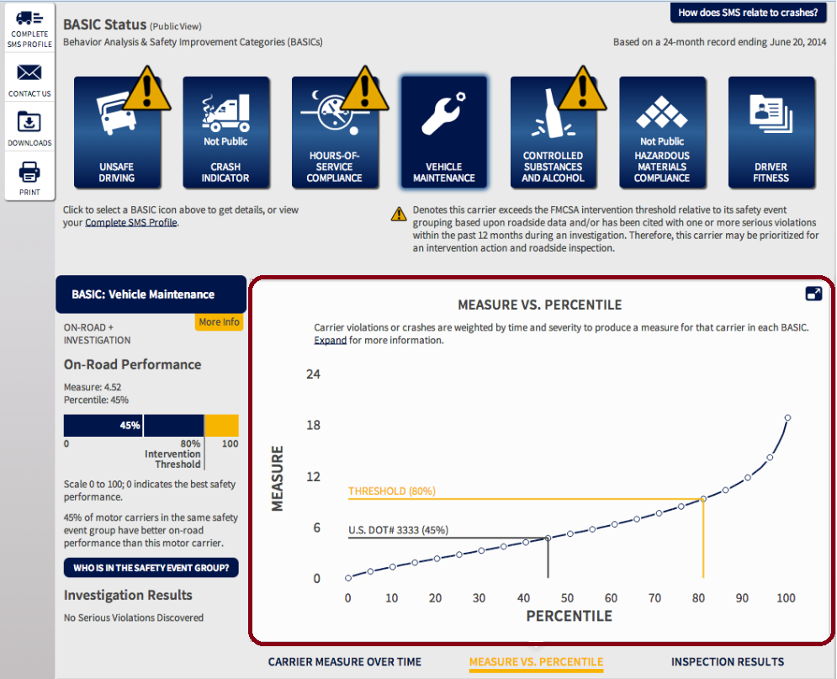
Measure vs. Percentile Graph
Click to expand graph

Slide 29
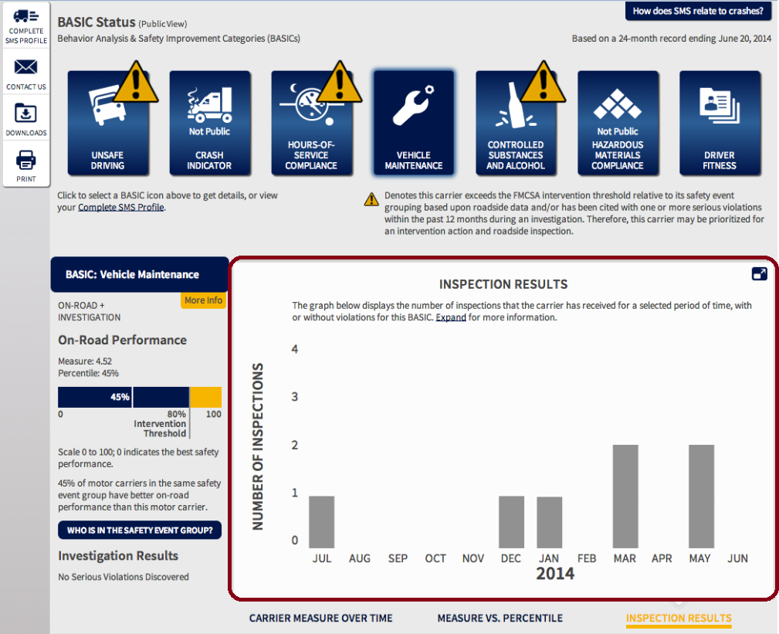
Inspection Results Graph
Click to expand graph

Slide 30
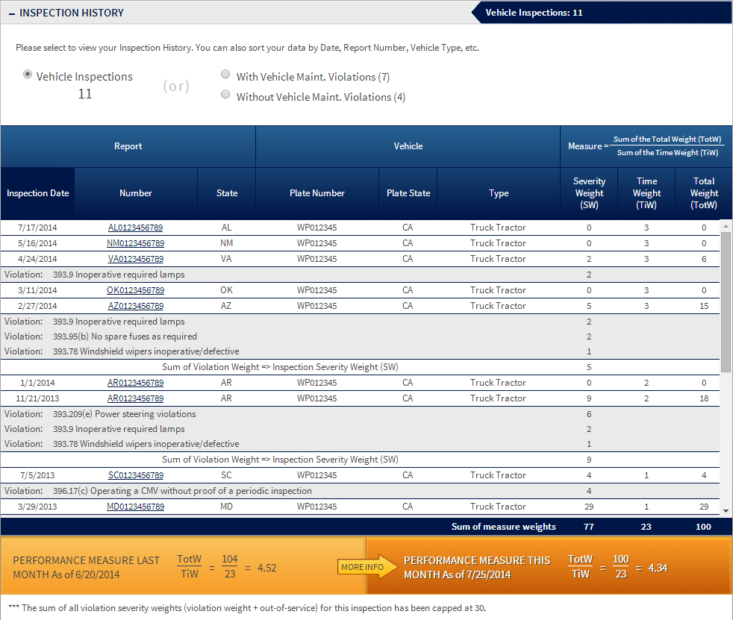

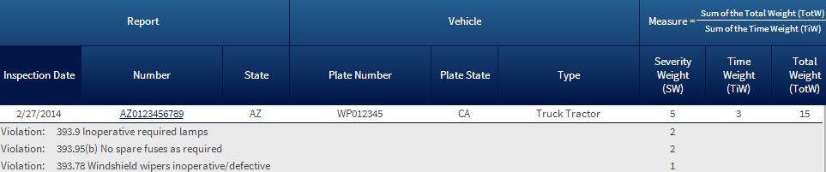

Inspection History

Slide 31
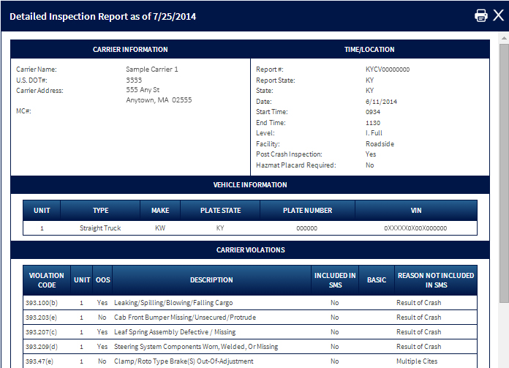
Detailed Inspection Report

Slide 32
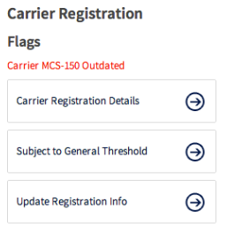
Carrier Registration
Includes “Carrier MCS-150 Outdated” flag to notify carrier that its MCS-150 form has not been updated in the past 24 months.
Includes “Carrier VMT Outdated” to notify carrier that its Vehicle Miles Traveled field does not reflect data from one of two previous years.
Carriers can click “Update Registration Info” to update their registration information.

Slide 33
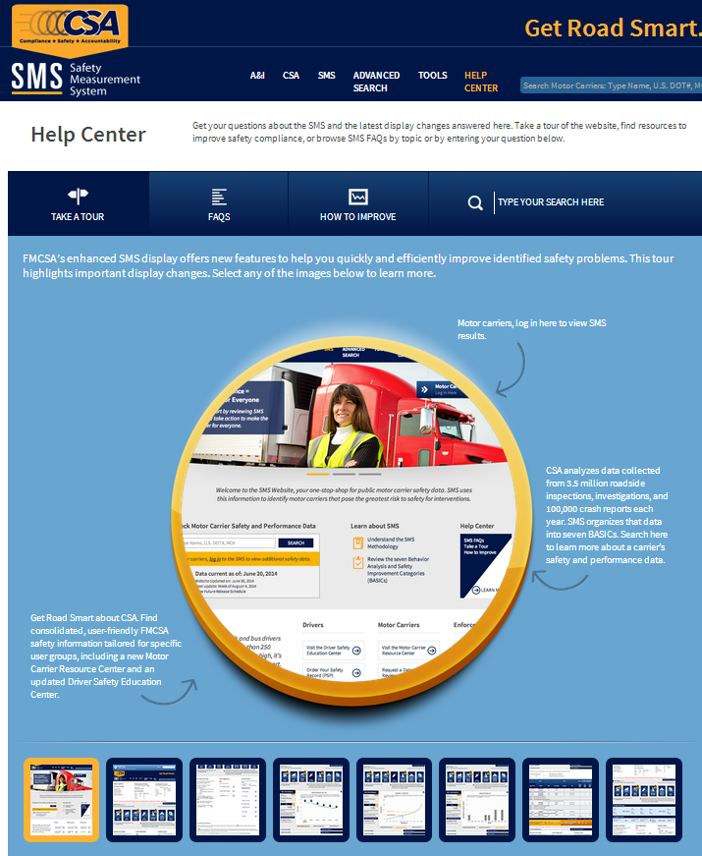

Slide 34
New Adjudicated Citations Policy
Effective August 23, 2014

Slide 35
New Policy to Improve Data Quality and Uniformity
    FMCSA is committed to improving the quality and uniformity of roadside inspection data.
    As part of this commitment, FMCSA is implementing a new adjudicated citations policy to improve the quality and uniformity of data in the Motor Carrier Management Information System (MCMIS) and the Agency’s other data systems, including the SMS and Pre-Employment Screening Program (PSP).

Slide 36
What Does Adjudicated Citation Mean?
  MCMIS contains records of inspections, including violations observed by law enforcement officers, during such commercial motor vehicle (CMV) inspections.
  Law enforcement officials, at their discretion, may issue citations for the violations recorded on the roadside inspection.

Slide 37
What Does Adjudicated Citation Mean? Cont.
    Citation: Refers to a notice, issued by a law enforcement officer to a CMV driver for a violation of State law or State- adopted Federal Motor Carrier Safety Regulation (FMCSR) or Hazardous Materials Regulation. The driver may contest the citation through a State-provided administrative or judicial system.
    Adjudicated Citation: Refers to a citation that has been contested and resolved through a due process proceeding in a State, local, or administrative tribunal, regardless of how the action is resolved, whether by a judge or prosecutor or as part of a plea agreement or otherwise.

Slide 38
Background
December 2, 2013 FR Notice: FMCSA announced proposed IT and policy changes and sought public comments.
  The proposed changes received widespread support from the motor carrier industry.
June 5, 2014 FR Notice: FMCSA announced implementation of the IT and policy changes starting on August 23, 2014.

Slide 39
How the New Policy Works
    Starting August 23, drivers and carriers may submit a Request for Data Review (RDR), through DataQs, seeking to include data on the results of adjudicated citations associated with violations on an inspection report.
    Not retroactive – only applies to inspections occurring on or after August 23, 2014.
    Documentation is essential:
      FMCSA’s data systems will not be automatically updated with adjudicated citation results.
      To initiate the process, drivers and carriers must submit RDRs with certified documentation of the results of the judicial proceeding.

Slide 40
How the New Policy Works Cont.
Drivers and carriers should not submit RDRs if their adjudicated citation results meet the following conditions or outcomes:
  Are associated with an inspection occurring before August 23, 2014.
  Indicate conviction of original charge.
The conviction result is based on the regulatory definition of “conviction” in the FMCSRs at 49 CFR 383.5 and 390.5.
  Are currently pending.
    Judge, administrative tribunal, or prosecutor has not heard or acted upon the corresponding citation and cited violations are still pending (e.g., probation before judgment).

Slide 41
How the New Policy Works Cont.
    States will review the RDR and documentation provided by the requestor.
    States will record the result of the adjudicated citation in State data systems, which will then impact FMCSA data systems upon an update of the system (i.e., SMS and PSP).

Slide 42
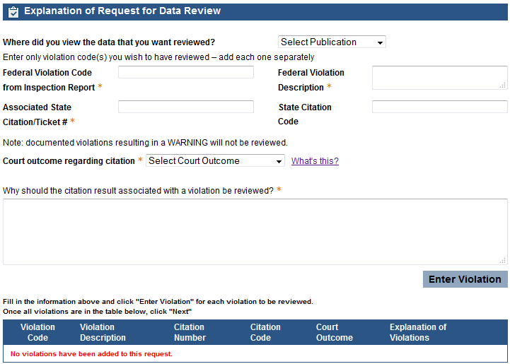
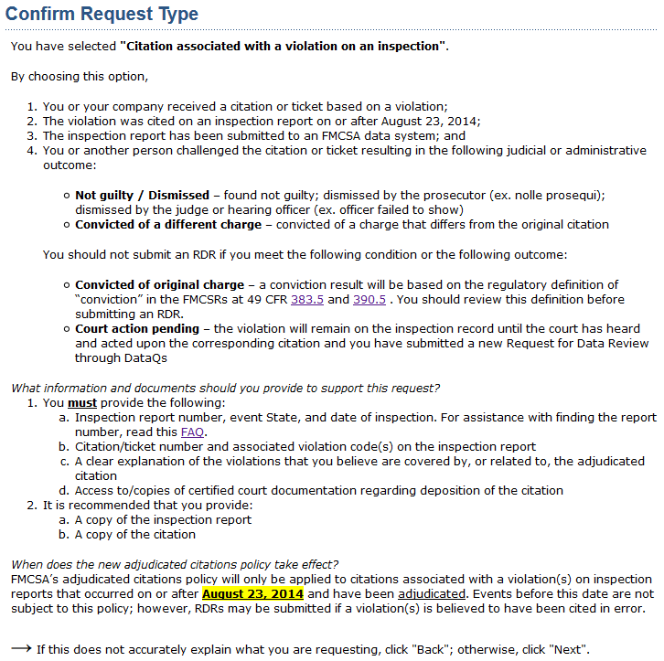
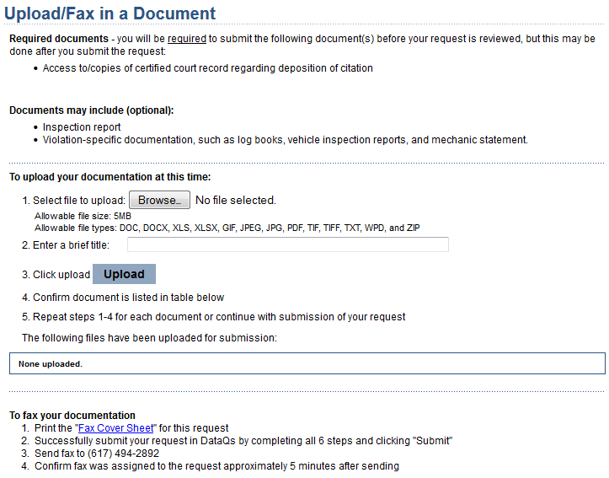
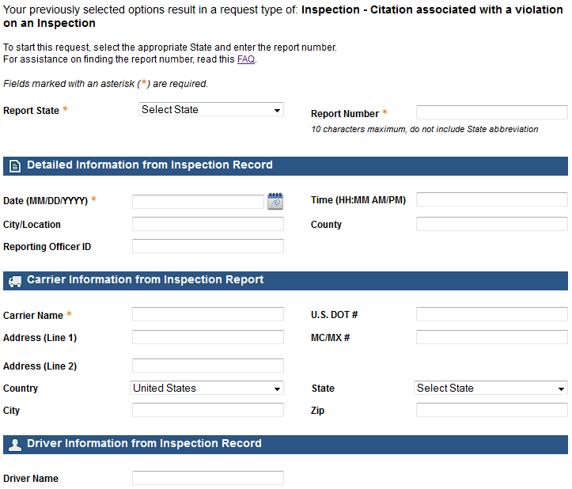
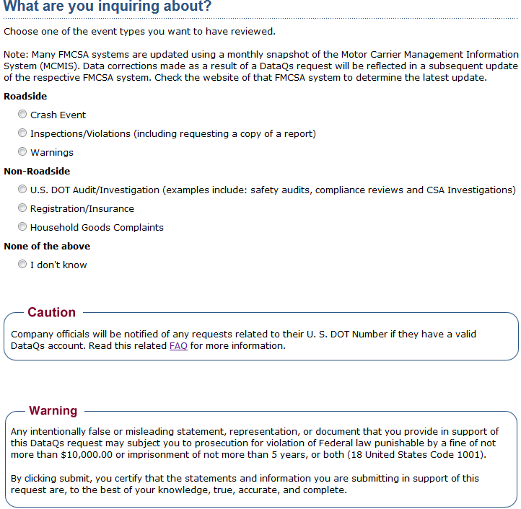
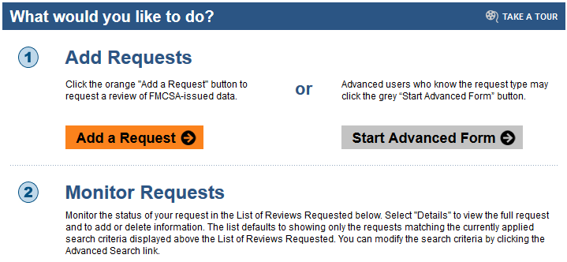
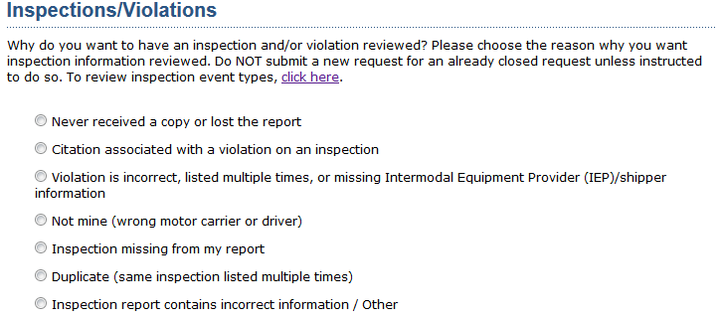
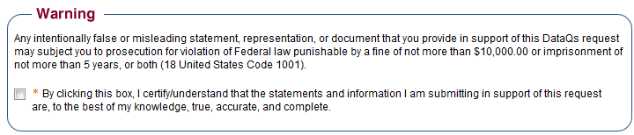
How to Submit an RDR in DataQs

Slide 43
How the New Policy Works Cont.
Adjudicated citation results will appear in SMS and PSP as follows:
Result of Adjudicated Citation Associated with a Violation | SMS | PSP
Dismissed without a fine or not guilty | Violation removed | Violation removed
Conviction of a different charge | Violation indicated as conviction of a different charge; SMS severity weight reduced to 1 | Violation indicated as conviction of a different charge
Conviction or dismissed with a fine | Violation retained | Violation retained
Carriers logged in to Portal or SMS will be able to see all of the violations listed on an inspection and associated adjudicated citation results.

Slide 44
FAQs

Slide 45
Question: Why did FMCSA make these SMS display enhancements?
Answer: FMCSA enhanced the display of safety data on the SMS Website to make it easy to understand and access for a variety of stakeholders. The display changes are based on feedback from motor carriers, drivers, enforcement, and other stakeholders, following a preview of the enhanced SMS Website. This effort is part of the Agency’s commitment to help everyone Get Road Smart about safety performance and compliance.

Slide 46
Question: Do the SMS Website enhancements include changes to the SMS methodology?
Answer: No. The SMS display enhancements are focused on the display of information on the SMS Website and do not change or modify the methodology itself, or the carrier safety rating, which is subject to the Safety Fitness Procedures at 49 CFR Part 385. These enhancements are designed to address feedback from stakeholders who want to better understand the SMS and its relationship to other FMCSA safety data.

Slide 47
Question: Is FMCSA considering making changes to the SMS methodology?
Answer: Yes. FMCSA is currently considering making changes to the SMS methodology. Items on the Agency’s radar include:
  Hazardous Materials Compliance BASIC.
  Severity weights.
  Utilization factor.
  Safety event groups.
  The Agency will apply the same systematic approach used for these SMS enhancements to make improvements to the methodology.

Slide 48
Question: When does the new adjudicated citations policy take effect?
Answer: Starting August 23, 2014, drivers and carriers will be able to request the inclusion of the results of adjudicated citations associated with roadside inspection violations that have been dismissed or pled to a different charge.

Slide 49
Question: Will the new policy be retroactive?
Answer: No. The process only applies to inspections conducted on or after August 23, 2014.

Slide 50
Question: Will FMCSA’s data systems be automatically updated when a citation is dismissed or pled to a different charge?
Answer: No. To initiate the process, drivers and carriers must submit RDRs with certified documentation of the judicial proceeding. It is the responsibility of drivers and carriers, including owner-operators, to make sure their safety records are complete and have the most current information possible.

Slide 51
Question: What should a driver or carrier do to request a review of the adjudication result for a citation with an associated violation?
Answer: To request a review:
Confirm that the adjudication citation result meets the criteria for an RDR (i.e., dismissed or pled to different charge).
Go to FMCSA’s DataQs Website, and register for free: https://dataqs.fmcsa.dot.gov/.
File an RDR on an inspection.
Select an adjudicated citation RDR type.
Provide supporting documentation.
Be responsive; additional documentation may be requested.

Slide 52
For Additional Support
  Visit the SMS Help Center for searchable FAQs and resources.
  Check out the SMS Display Key Terms Glossary for user-friendly definitions.
  Review the June 5, 2014 FR Notice for more information on the new adjudicated citations policy: http://www.fmcsa.dot.gov/regulations/rulemaking/2014-13022.
  Ask questions via the CSA Website at http://csa.fmcsa.dot.gov/CSA_Feedback.aspx or call 877-254-5365.

Slide 53
Help Us Build a Nationwide Commitment to Safety
  Educate carriers and drivers
  Understand the SMS and the BASICs
  Subscribe to the CSA Outreach Website and visit it often for updates (http://csa.fmcsa.dot.gov)
  Ensure compliance
  Review and address safety problems immediately (http://ai.fmcsa.dot.gov/SMS/Default.aspx)
  Check and update records
  Routinely monitor and review all inspection and crash data
  Question potentially incorrect data (DataQs: https://dataqs.fmcsa.dot.gov)
  Update your MCS-150 form and VMT data

