Slide 1
The Life Cycle of a Roadside Inspection Violation
(Part 2)
Louisville, KY
April 2013

Slide 2
Life Cycle Seminar (Part 2): Agenda
Compliance, Safety, Accountability (CSA) Overview
  Safety Measurement System (SMS), Enhancements and Effectiveness
Safety Data on Drivers
Data Qs: the process for requesting review and correcting inspection data
Interventions: designed to change carrier behavior
CSA Website Demonstration
2013 Plans
Roundtable Q&A Session

Slide 3

What is CSA?
CSA is a program of the Federal Motor Carrier Safety Administration (FMCSA)
FMCSA’s mission is to prevent crashes, injuries, and fatalities involving large trucks and buses
CSA has not resulted in any new regulations
CSA was designed, field-tested, and refined over five years prior to national launch in December 2010

Slide 4
CSA’s Three Core Components
A Safety Measurement System (SMS) that:
  Identifies and categorizes unsafe carrier and driver behaviors that lead to crashes
  Uses all safety-based roadside inspection violations to assess compliance with existing regulations
  Includes investigation findings
A Safety Interventions process that:
  Includes an array of interventions
  Focuses on specific unsafe behaviors
  Identifies causes of safety problems
  Defines and requires corrective actions
  A Safety Fitness Determination (SFD) process that:
  Requires rulemaking,
  Would be incorporate on-the-road safety performance in addition to investigation findings

Slide 5
Safety Measurement System (SMS)
SMS is FMCSA’s workload prioritization tool that:
  Uses State-reported crash records and roadside inspection violations to identify carriers for FMCSA intervention
  Previous system used only out-of-service and certain moving violations
  Uses 24 months of data; recent events are weighted more heavily than older ones
  Weights violations based on relationship to crash risk

Slide 6
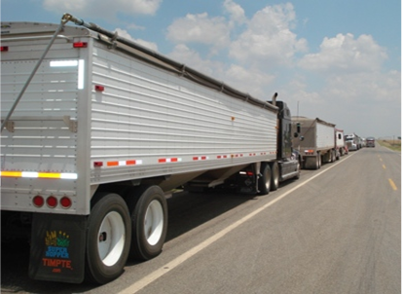
SMS (cont.)
  Calculates safety performance based on seven Behavior Analysis and Safety Improvement Categories (BASICs)
  Triggers the Safety Interventions process (e.g., warning letters, investigations)
  Will feed the new SFD process once rulemaking is completed
  Is designed to be continually improved as more information is available through data and analysis

Slide 7
SMS Methodology Overview
Gather 24 months of on-road safety event data (i.e., inspections, crashes) to create a safety event history
Place each carrier violation and/or crash into a BASIC
Convert BASIC data into a quantifiable measure/rate
  Time, severity, OOS weight
Develop a percentile rank for each BASIC based on each carrier BASIC measure
  Safety Event Groups
Safety Event Data
BASIC Measures
Percentile
BASIC Data

Slide 8
SMS BASICs
BASICs focus on behaviors linked to crash risk
  Public
  Unsafe Driving (Parts 392 & 397)
  Hours-of-Service (HOS) Compliance (Parts 392 & 395)
  Driver Fitness (Parts 383 & 391)
  Controlled Substances/Alcohol (Parts 382 & 392)
  Vehicle Maintenance (Parts 392, 393 & 396)
  Not Public
  Hazardous Materials (HM) Compliance (Federal Motor Carrier Safety Regulation Part 397 & HM Regulations (HMRs) Parts 171, 172, 173, 177, 178, 179, and 180)
  Crash Indicator

Slide 9

SMS (cont.)
Carriers with BASICs above the threshold ( ) are prioritized for intervention
Percentile ranks are determined by comparing carriers’ measures other measures of carriers with similar number of safety events
Clean Roadside Inspections are used in SMS and can improve a carrier’s BASIC percentile ranks
Motor carriers do NOT inherit any of a newly-hired driver’s past violations
Only those inspections that a driver receives while driving under a carrier’s authority can be applied to that carrier’s SMS profile
  Driver violations remain on the carrier’s SMS for two years, even if the driver was fired

Slide 10
SMS Screenshots
The following slides provide
examples of SMS results and data

Slide 11
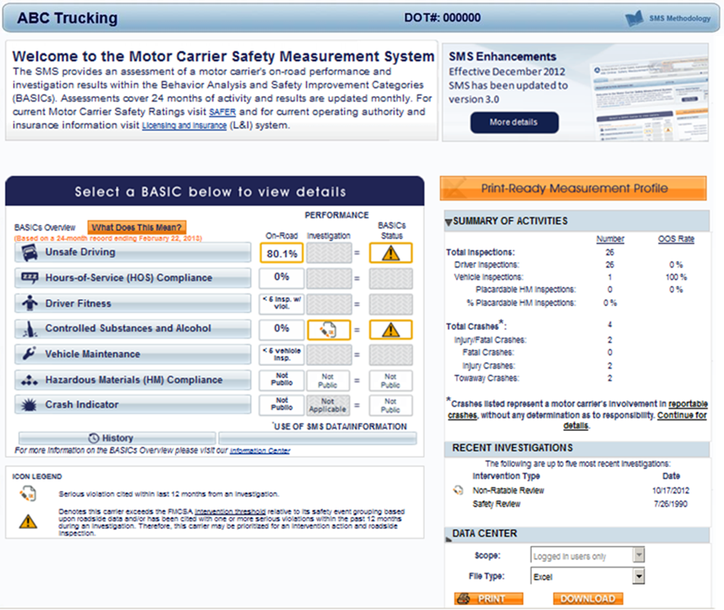
Carrier Measurement: SMS Results

Slide 12
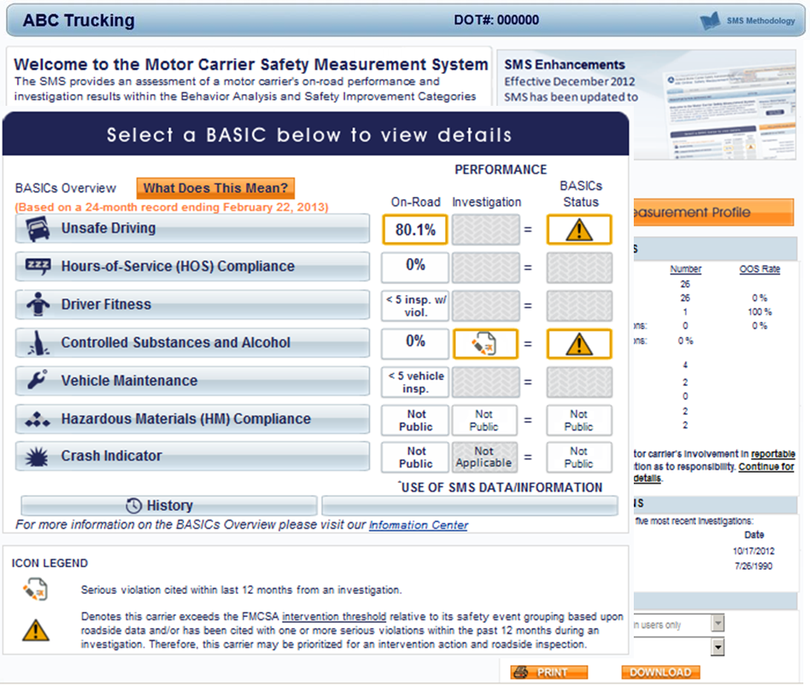
Carrier Measurement: SMS Results

Slide 13
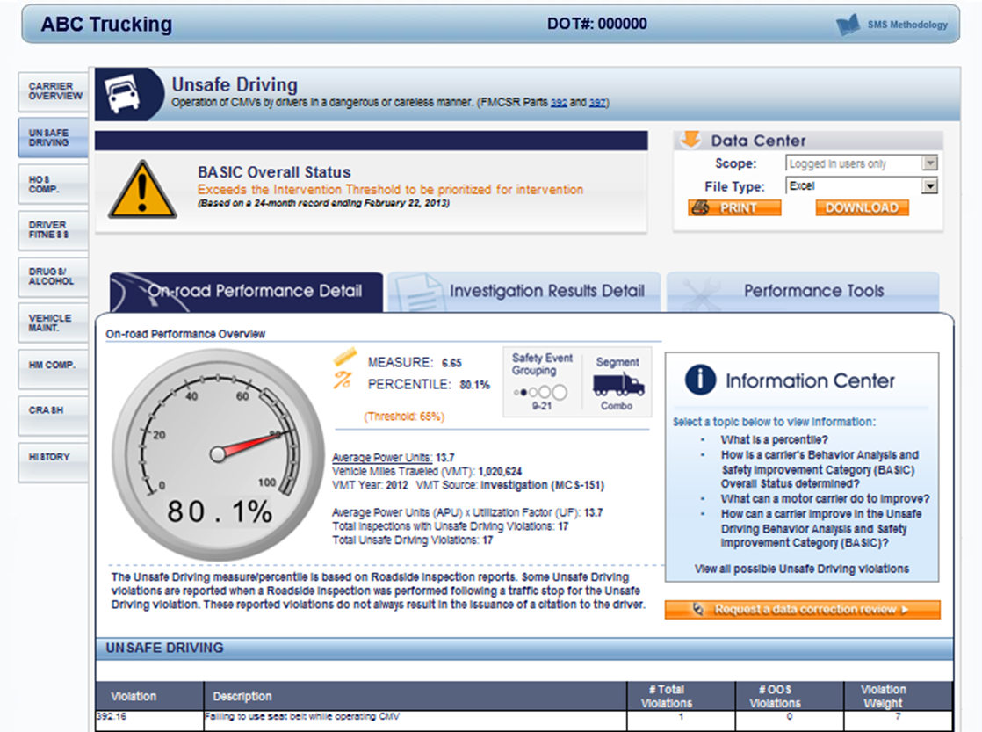
Violation Details Provided in the SMS

Slide 14
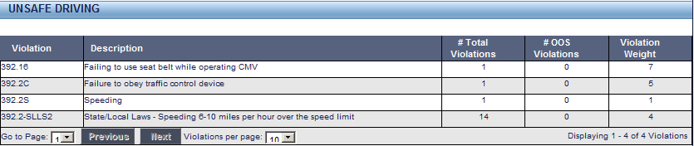
Further Drilldown in the SMS

Slide 15
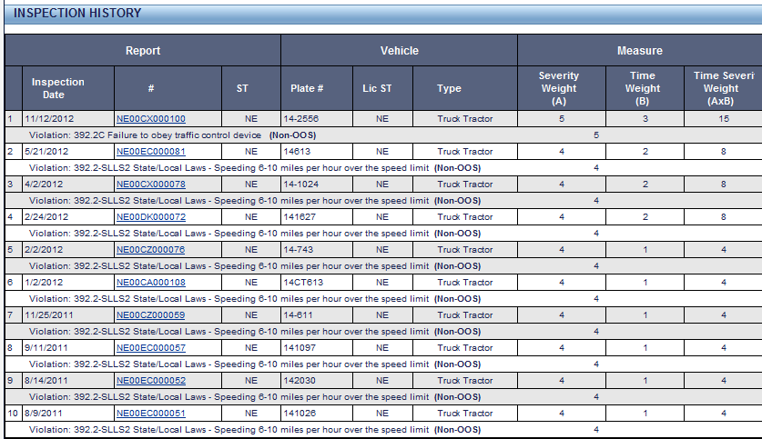
Further Drilldown in the SMS

Slide 16
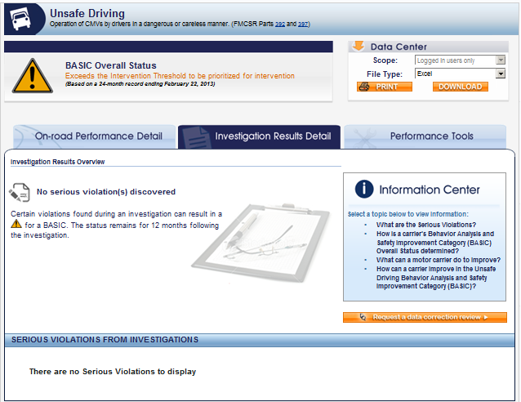
Further Drilldown in the SMS

Slide 17
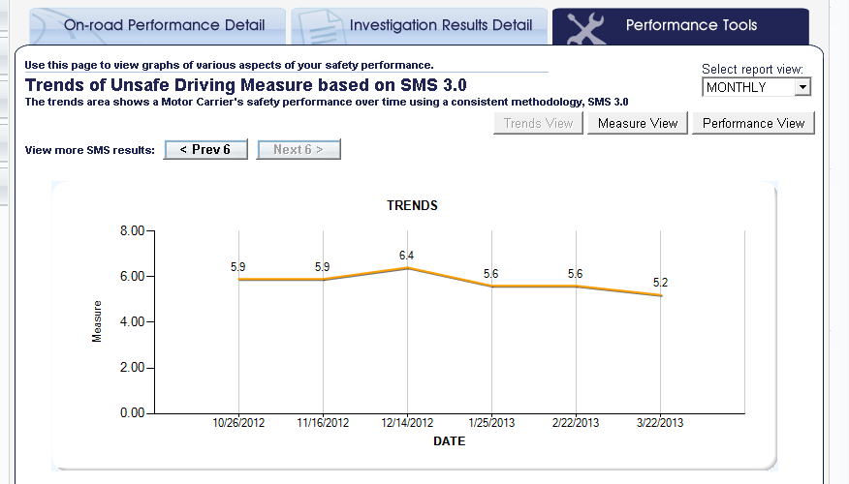
Further Drilldown in the SMS

Slide 18
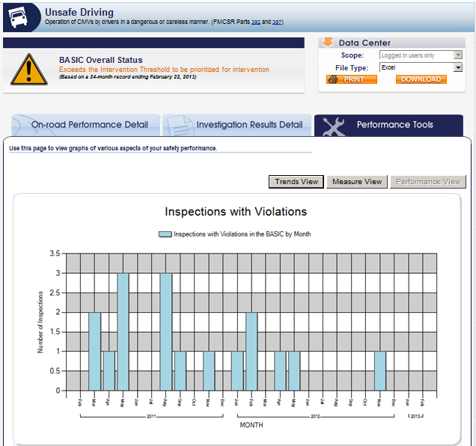
Further Drilldown in the SMS

Slide 19

Recent SMS Improvements

Slide 20
Recent SMS Changes
March 2012
Motor carriers and enforcement staff previewed the changes before implementation
Preview participants were able to compare/ contrast current vs. proposed
View impact on measures and percentile ranks
March 27, 2012 through July 30,2012
Federal Register Docket open for comments about the SMS Preview
December 2012
SMS public website updated with the SMS changes discussed
  Both logged-in users and the general public can see percentile ranks
  Crash Indicator and the HM Compliance BASIC percentiles are available to only logged-in users

Slide 21
SMS Improvements
  Strengthened the Vehicle Maintenance BASIC by incorporating cargo/load securement violations from the Cargo-Related BASIC
  Allows for appropriate workload prioritization while reducing a bias in the Cargo-Related BASIC whereby flatbed operators are disproportionately identified for intervention
  Changed the Cargo-Related BASIC to the HM Compliance BASIC to better identify safety problems related to HM
  Removed load securement violations so that only HM violations remain; consequences of crashes and cargo spills can be greatly exacerbated when HM are involved
Notes:
21

Slide 22
SMS Improvements (cont.)
  Better aligned the SMS with IEP regulations
  SMS now properly attributes each Intermodal Equipment Provider (IEP) trailer violation to either the IEP or the motor carrier based on the ability of the driver to find the violation as part of a pre-trip inspection
  IEP violations assigned to a motor carrier are now used towards calculating the carrier’s Vehicle Maintenance BASIC
  Aligned violations included in the SMS with CVSA inspection levels by eliminating vehicle violations derived from driver-only inspections and driver violations from vehicle-only inspections
  Prompted by enforcement and industry concerns that some vehicle violations fall outside the scope of a driver-only inspection and could bias the BASIC results
Notes:
22

Slide 23
SMS Improvements (cont.)
  More accurately identify carriers involved in transporting HM or passengers
These carriers are subject to more stringent thresholds in the SMS
HM Carriers New definition enables FMCSA to focus resources on carriers involved in the majority of placardable HM transport
At least 2 HM placardable vehicle inspections; 1 within past 12 months At least 5% total inspections indicated as HM placardable vehicle inspections
Passenger Carriers New definition removes many low-capacity vehicles (e.g., vans and taxis) that are generally outside of FMCSA’s authority
Adds all for-hire carriers with 9-15 passenger capacity vehicles and private carriers with 16+ capacity Removes all carriers with only 1-8 capacity and private carriers with 1-15 passenger capacity
Notes:
23

Slide 24
SMS Improvements (cont.)
  Modified the SMS Display to:
  Replace the terms Insufficient Data and Inconclusive to fact-based definitions
  Break out crashes with injuries and crashes with fatalities
Removed 1 to 5 mph speeding violations
  FMCSA has aligned speeding violations to be consistent with current speedometer regulations (49 CFR 393.82) that require speedometers to be accurate within 5 mph
  Applies to the prior 24 months of data, and all future SMS data
Lowered the severity weight for speeding violations that do not designate a mph range above the speed limit to 1.
Notes:
24

Slide 25

SMS Improvements (cont.)
Aligned the severity weight of paper and electronic logbook violations (they are now weighted equally)
Changed the name of the Fatigued Driving (HOS) BASIC to the HOS Compliance BASIC
  This BASIC continues to have a strong association with future crash risk.
  Change was made to reflect that the BASIC includes HOS recordkeeping requirements that, by themselves, do not necessarily indicate fatigued driving or driving in excess of allowable hours.
Notes:
25

Slide 26
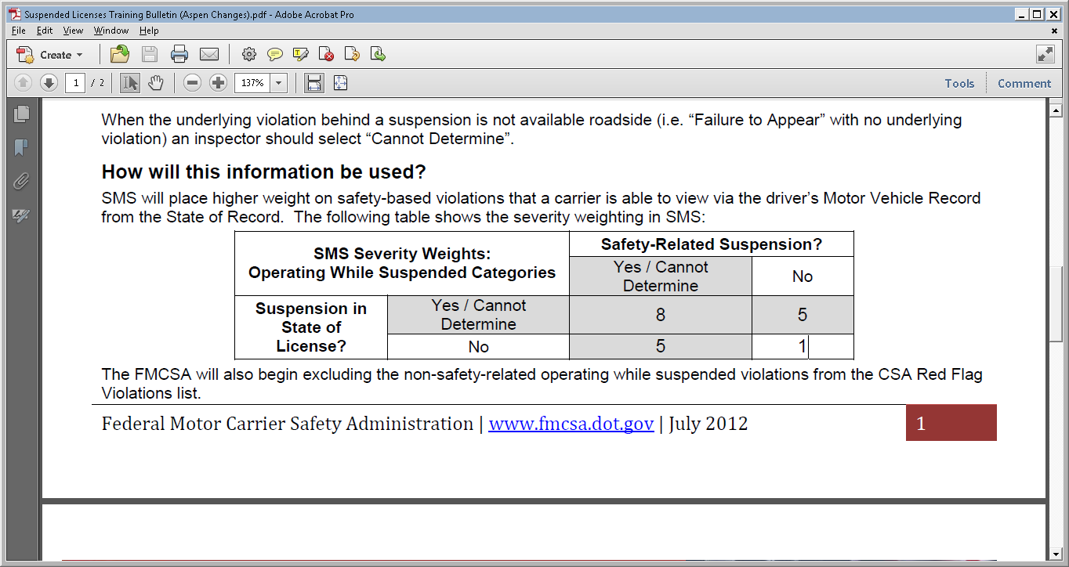
Suspended License Changes (ASPEN Change)
Operating CMV while disqualified / CDL suspended (391.15A and 383.51A)
safety- or non-safety-based suspension
whether or not the carrier had the capacity to know about the suspension

Slide 27
Effectiveness Tests and Results

Slide 28
CSA Effectiveness
  FMCSA is continually monitoring the effectiveness of the CSA program
  FMCSA plans to have a complete CSA effectiveness report peer reviewed by an independent third party

Slide 29
Overall CSA Program Effectiveness
The assessment of the CSA program effectiveness will build off and include each of the four elements
  SMS Effectiveness
  Intervention Effectiveness
  Refresh of independent evaluation effectiveness measures
  New effectiveness measures
Results will be refreshed at regular intervals to assess the effectiveness over time

Slide 30
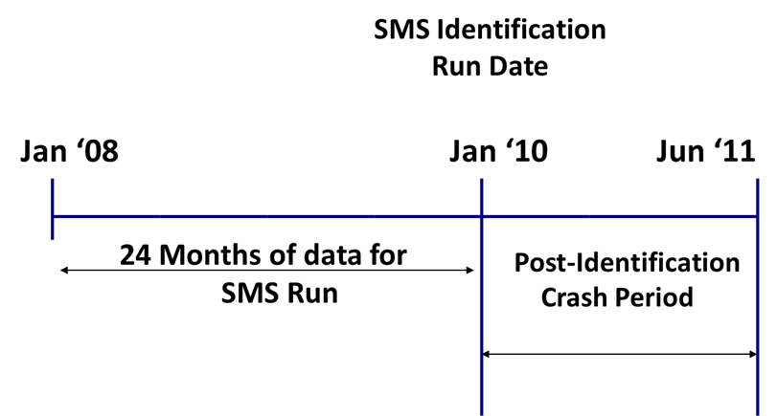
1. SMS Effectiveness Report
Objective
  Quantify how effectively the SMS identifies high-risk motor carriers
Methodology
  Use historical data to examine the future crash rate of motor carriers
Results will be published following peer review

Slide 31
Effectiveness Results
Carriers meeting the above definition of “high risk” have substantially higher crash rates: more than twice the crash rate of the general carrier population
Crash OR HOS Compliance OR Unsafe ≥ 85
+
1 other BASIC at or above the “all other” motor carrier threshold
Any 4 or more BASICs at or above the “all other” motor carrier threshold
OR
Group | # Carriers | Post Crashes per 100 Post PU
Carriers under FMCSA's Jurisdiction | 276,855 | 3.58
Carriers with Sufficient Data for 1+ BASICs (SMS 3.0) | 161,555 | 3.82
Carriers with Above Threshold in 1+ BASICs (SMS 3.0) | 41,789 | 5.05
High-Risk Carriers | 6,731 | 8.15

Slide 32
Effectiveness Results (cont.)
Unsafe Driving, HOS Compliance, Vehicle Maintenance BASICs, and the Crash Indicator are the best predictors of future crash risk
Other BASICs show a weaker relationship to crash risk
FMCSA optimizes resources through more stringent Intervention Thresholds for BASICs with strongest associations to crash risk
Crash rates of Carriers above and below BASIC thresholds
BASIC | Above Threshold : Crashes per 100 PU | Below Threshold: Crashes per 100 PU | Increase in Crash Rate
Unsafe Driving | 7.10 | 3.90 | 82%
HOS Compliance | 6.97 | 4.00 | 74%
Driver Fitness | 2.85 | 4.43 | -36%
Controlled Substances / Alcohol | 2.81 | 5.25 | -47%
Vehicle Maintenance | 5.79 | 3.87 | 50%
HM Compliance | 5.27 | 4.04 | 31%
Crash | 6.59 | 3.58 | 84%
1+ BASIC (any BASIC) | 5.05 | 3.05 | 66%

Slide 33
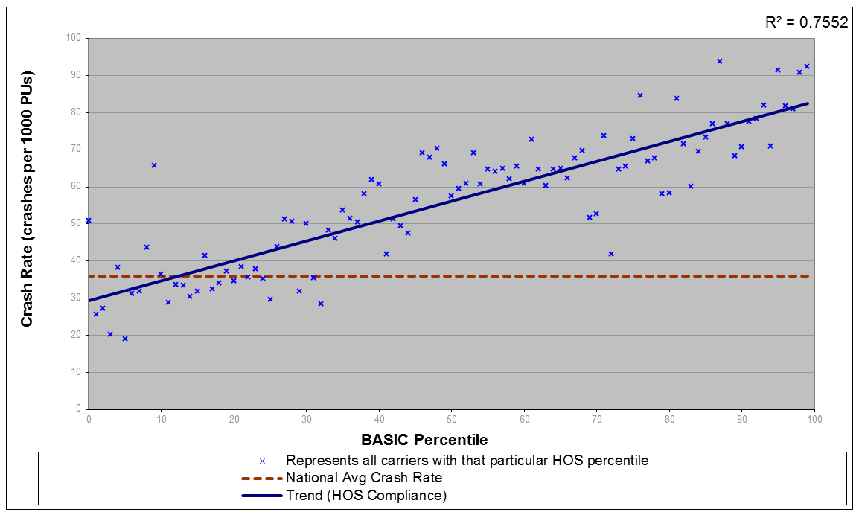
Effectiveness – HOS Compliance BASIC
Strong relationship between HOS Compliance BASIC and future crash risk
Recent American Transportation Research Institute (ATRI) paper shows similar findings

Slide 34
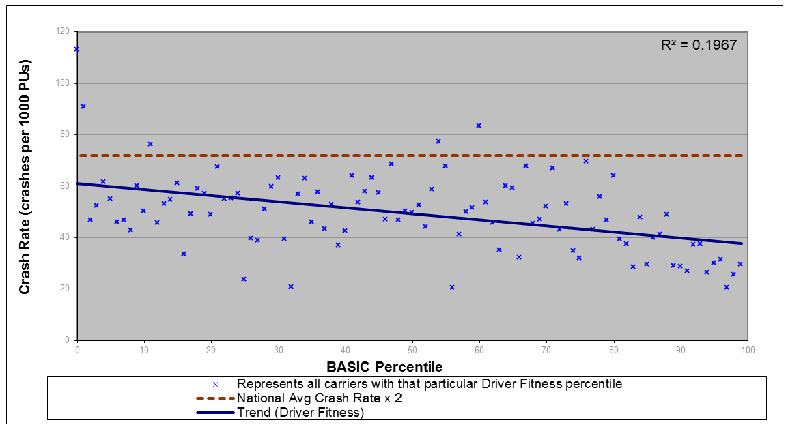
Effectiveness – Driver Fitness BASIC
Negative relationship between Driver Fitness BASIC and future crash risk
Recent ATRI paper shows similar findings
Three quarters of carriers above Driver Fitness, exceed threshold in another BASIC
Recent Aspen improvements provide for higher severity weights for safety-based “operating while suspended” violations

Slide 35
SMS Effectiveness - ATRI Report Summary
Findings:
  Positive relationship between Unsafe, HOS, and Vehicle BASICs and crash risk.
  Negative relationship between Driver Fitness and Controlled Substance/Alcohol BASICs and crash risk.
  The more BASIC percentiles at ‘alert’, the higher the crash risk.
Recommendations:
  Rank carriers by number of BASICs at ‘alert’.
  Present profiles on the CSA website based on number of ‘alerts’.

Slide 36
2. CSA Intervention Effectiveness
CSA Intervention Effectiveness Model is currently under development (replaces CREM)
Calculate pre vs. post intervention crash rates and compares to control groups
Measures crashes avoided, injuries prevented, and lives saved, as a result of interventions in a given year

Slide 37
3. Refresh of Effectiveness Metrics
The independent evaluation by UMTRI of the CSA Operational Model Test will be updated based on national implementation of the CSA program
  Not all measures will be updated ; dependent on the availability of data
  Will apply lessons learned and improve methodology
Example measures to be updated based on national implementation:
  Crash rates over time for the motor carrier population
  Crash rates by motor carrier’s BASIC performance
  Intervention cycle analysis – what interventions have motor carrier’s received since implementation
  Estimating benefits of various interventions

Slide 38
4. New Effectiveness Measures
New effectiveness measures will be developed to evaluate the CSA program
The following may be potential new measures:
  Further break out existing measures by carrier operation type (e.g. Hazardous Material or Passenger Carriers)
  Violation rates over time
    By BASIC performance
    Before and after interventions
  BASIC measure trends over time
  Measures looking at the volume of traffic viewing SMS websites

Slide 39
CSA Stats
Since CSA rollout (Dec 2010), most dramatic decrease in violation rates in a decade
  violations per roadside inspection are down nearly 14 percent and
  driver violations per inspection are down 17 percent
SMS identifies high-risk carriers have
  twice national crash rate
  56% more crashes than carriers identified using SafeStat
SMS Online hosted 48 million user sessions in 2012
  Ten fold increase over SafeStat and 60% increase since last year
The SMS has enough performance data to evaluate nearly 40% of active carriers (these carriers are involved in >92% of reported crashes)
As of Dec. 2012, FMCSA sent more than 70,000 warning letters
Notes:
39

Slide 40
What about safety data on drivers?

Slide 41

Driver Safety Data
  FMCSA uses violations reported to Agency on an inspection report.
  During the inspection, inspector may also choose to issue a State warning/citation/ticket for the infraction.

Slide 42
Driver Safety Data: Two Distinct Records
  State Motor Vehicle Record (MVR)
  Federal Pre-Employment Screening Program (PSP)

Slide 43
Driver Safety Data - State
State Motor Vehicle Record (MVR)
  Same system as before, not impacted by CSA
  Includes State conviction data
  States (not Federal Government) may suspend CDL based on conviction data accumulated on MVR
  Employers required by Federal regulations to check annually (49 CFR 391.25)
  To acquire this report contact the State Department of Motor Vehicles that issued your CDL

Slide 44
Driver Safety Data - Federal
Federal Pre-Employment Screening Program (PSP) Report
  Congress mandated program independent of CSA
  Voluntary screening tool that allows motor carriers and drivers to purchase Federal inspection and crash history
    5 years reportable crashes
    3 years inspections – includes violations recorded on inspections and also clean inspections
  Carrier access to report requires driver consent
  Driver can acquire his/her report anytime for a $10 fee at www.psp.fmcsa.dot.gov or for free via FOIA request
  PSP does not directly impact a driver’s CDL
  No scores, points, ratings or assessments under PSP

Slide 45
Driver Safety Data - Non-Government
Carriers Evaluating Drivers
  Carriers and independent third parties aggregate PSP and other driver data and refer to it as a “CSA score” or “CSA driver scorecard”
  Important to understand that this evaluation is coming from the carrier, NOT the Federal/State Government.
  There is no universal evaluation method
  Drivers should ask their carriers
  how they are being evaluated

Slide 46
Disputing Driver Data
State Data (citation/tickets)→ State Court
  Challenge citation data in State court, otherwise data goes on driver’s MVR, possibly impacting your CDL
Federal Data (recorded violations)→ DataQs
  Drivers can dispute Federal data on their PSP via DataQs
  Visit DataQs Website: https://dataqs.fmcsa.dot.gov/ (Register for free)
  Follow the instructions on the site to file a request for data review (RDR) on an inspection and/or reportable crash
  Must provide supporting documentation when filing an RDR
  RDRs are handled by the State where the inspection/crash occurred
If a driver receives a Federal violation and a State citation/ticket for the same infraction:
  The driver must dispute them separately using the appropriate method above
  Removal of a violation/citation under one system DOES NOT guarantee automatic removal from the other

Slide 47
Driver Safety Measurement System (DSMS)
FMCSA’s internal tool to address the safety of CMV drivers:
  Provides enhanced information on individual drivers to FMCSA investigators to identify drivers with safety problems
  Allows for prioritizing driver sampling during carrier investigation
  Supports investigator follow-up on significant violations (e.g., Red Flag Violations)
  DSMS data are not available to the public or to employing motor carriers; they are used only by FMCSA as an investigative tool
Red Flag Violations:
  Reviewed during a carrier investigation
Under CSA, individual drivers are not assigned safety ratings or safety fitness determinations

Slide 48
DataQs
Mike Wilson (ISP)

Slide 49
Safety Interventions

Slide 50

Safety Interventions Process
The Safety Interventions process addresses the:
  WHAT
  Discovering violations and
  defining the problem
  WHY
  Identifying the cause or
  where the processes broke down
  HOW
  Determining how to fix it/prevent it by using the Safety Management Cycle (SMC)

Slide 51
CSA Intervention Tools
Increasing Severity
Safety Measurement BASIC Scores
WARNING
LETTER
INVESTIGATION INTERVENTIONS
Offsite
Focused Onsite
Comprehensive Onsite
.
.
.
.
.
Safety
Mgmt
Cycle
FOLLOW-ON
CORRECTIVE ACTIONS
CSP
NOV
NOC/OOS
TARGETED ROADSIDE INSPECTION

Slide 52
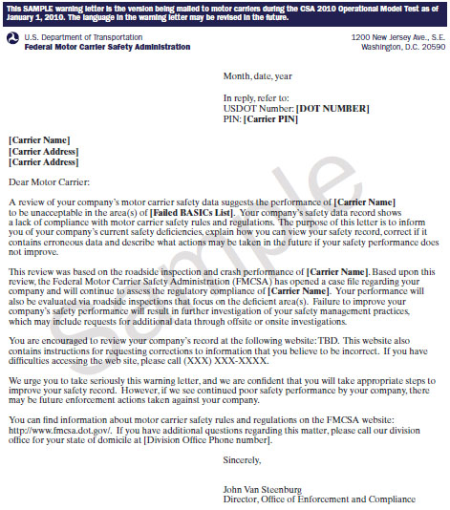
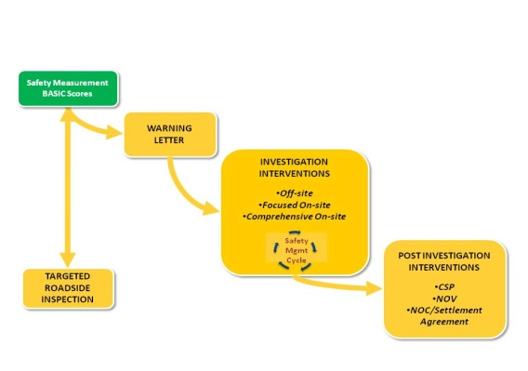
CSA Warning Letter
Warning Letter

Slide 53
BASICs Requiring Investigation
Any BASIC exceeding the threshold (percentile)
OR
Any BASIC with a Serious Violation on the most recent investigation
OR
BASICs associated with a complaint

Slide 54

CSA Carrier Investigations
Shifted from 1 Compliance Review (CR) to 3 Investigation Options
  Offsite
  Focused Onsite
  Comprehensive Onsite
Focused on BASICs requiring investigation
INVESTIGATION INTERVENTIONS
Offsite
Focused Onsite
Comprehensive Onsite
Safety
Mgmt
Cycle
Notes:
CSA Overview & Webinar 1 Slides 54
Module 1

Slide 55
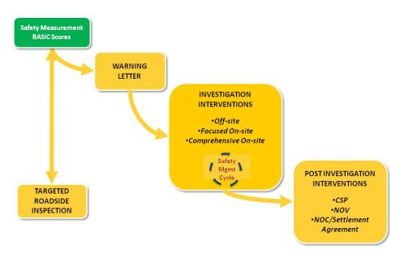
CSA Investigation Process
Shifting from What to What, Why, and How
Perform investigation to identify violations and corresponding process breakdowns in the Safety Management Cycle
Identify and discuss recommended remedies to improve the carrier’s Safety Management Processes
INVESTIGATION INTERVENTIONS
Offsite
Focused Onsite
Comprehensive Onsite
Safety
Mgmt
Cycle

Slide 56
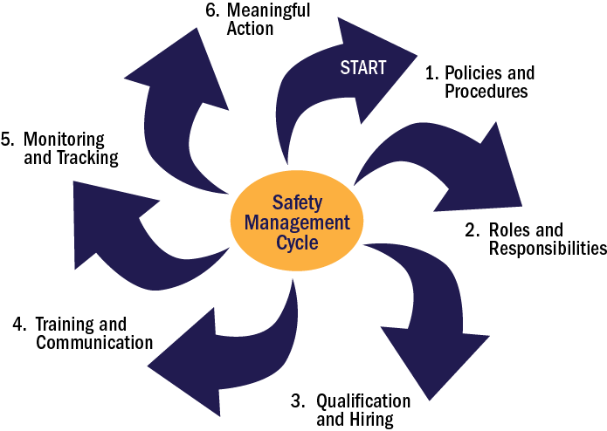
Safety Management Cycle
What Safety Management Processes are breaking down?
Why are the Safety Management Processes breaking down?

Slide 57
Safety Management Cycle Assessment
What is the violation?
What Safety Management process is broken/missing?
Why is the process breaking down?
How can the carrier best address these breakdowns?
Part B. Violations | Part B. Safety Management Breakdowns | Part B. Description of Process Breakdown | Part B. Remedies
 | Policies and Procedures Roles and Responsibilities Qualification and Hiring Training and Communication Monitoring and Tracking Meaningful Action |  | Implement Safety Improvement Practices Seek out Resources: Local Resources/ Associations Understand Why Compliance Saves Time and Money Apply Adequate Resources Document and Follow through on Action Plans

Slide 58
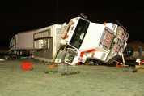
Crash BASIC Investigation (CBI)
An onsite in-depth examination of a carrier’s recent reportable crash events
Concentrates on drivers and vehicles involved in crashes
CBI Crash Analysis Toolkit

Slide 59
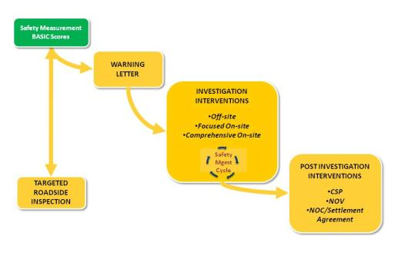
CSA Follow-On Corrective Actions
Notice of Claim (NOC)/ Operations out-of-service order (OOS)
Notice of Violation (NOV)
Cooperative Safety Plan (CSP)
FOLLOW-ON CORRECTIVE ACTIONS
CSP
NOV
NOC/OOS

Slide 60
Rating Process
Existing Safety Rating Process:
Defined in regulations: Part 385
Based on the results of an onsite investigation
Critical / Acute violations impact factors
Comprehensive Onsite Investigations
  May result in Satisfactory, Conditional, Unsatisfactory
Focused Onsite Investigations
  May result in Conditional or Unsatisfactory

Slide 61
SFD
Proposed Safety Fitness Determination (SFD):
Would require rulemaking
Would continue to include major safety violations found as part of investigations
Would also incorporate on-road safety performance
Considerations:
  Absolute (measure) vs. Relative performance (percentile)
  Use of crash data
  Safety event groups
  Due process
Draft rulemaking is currently under development

Slide 62
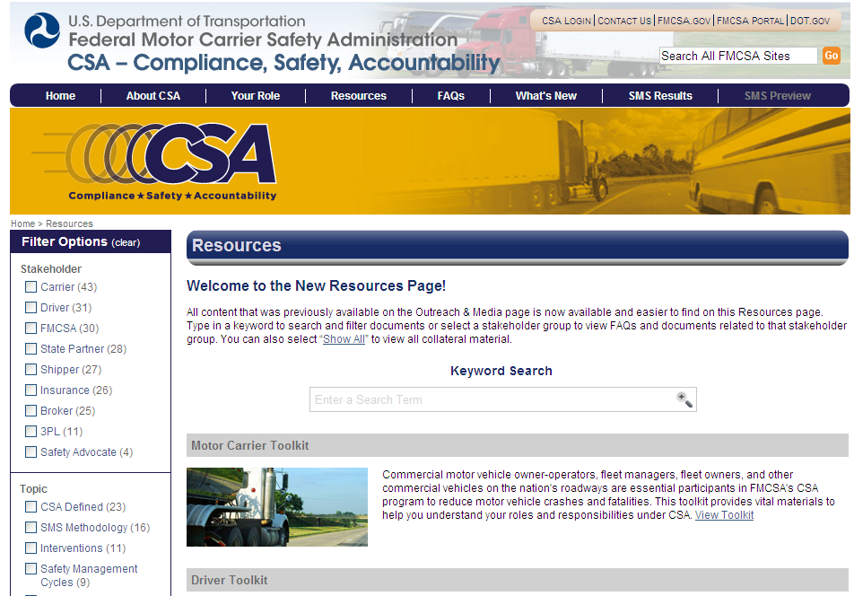
Website Demonstration http://csa.fmcsa.dot.gov/resources

Slide 63
2013 Plans
Enhancements to public display of SMS data
Analyzing the impact of proposed changes
Crash Weighting Plan
Safety Fitness Determination (SFD) – Notice of Proposed Rulemaking

Slide 64
SMS Public Display Enhancements
Enhancements under development
Objectives:
  Reinforce SMS as prioritization
  Recognize distinctions between BASICs and crash risk
  Focus on setting foundation for SFD
  Reinforce safety mission
  One stop shop
  Address concerns with “insufficient data” carriers
  Retain detailed data
Proposed enhancements would be previewed

Slide 65
Potential future Improvements to SMS
What kind of changes to SMS are under examination?
    Comprehensive modifications to roadside violation severity weights
    Recalibration of the Utilization Factor used to incorporate VMT for the Crash and Unsafe Driving BASICs
    Adjustment to safety event groupings in all BASICs

Slide 66
Recap of Improvements to SMS and broader CSA
What kind of changes to SMS are being considered for the next round of proposed improvements?
    Comprehensive modifications to roadside violation severity weights per MCSAC
    Recalibration of the Utilization Factor used to incorporate VMT for the Crash and Unsafe Driving BASICs
    Adjustment to safety event groupings in all BASICs
    Other?

Slide 67
Crash Weighting Study
SMS currently uses all crashes which has shown to be one of the better predictors of future crash risk
FMCSA is conducing research study to better understand the safety benefits of adjusting crash weights in SMS based on the motor carrier’s role in the crash (i.e. preventability)
Analysis complete summer 2013

Slide 68
Crash Weighting – Three Research Questions
1. Do police accident reports (PARs) across the nation provide sufficient, consistent, and reliable information to support crash weighting determinations?
2. Will a crash weighting determination process offer an even stronger predictor of crash risk than crash involvement and how will crash weighting be implemented into SMS?
3. How would the Agency manage the process for making crash weight determinations including public input to the process?

Slide 69
Crash Weighting – Benefit Analysis Approach
Conduct literature review to examine similar studies
Create several carrier based and driver based models to determine if weighted crashes are a better predictor of future crash risk than crash involvement based on available data
Optimize the SMS Crash Indicator by using the SMS effectiveness test

Slide 70
Crash Weighting
Complete plan is available at:
  https://csa.fmcsa.dot.gov/Documents/CrashWeightingResearchPlan_7-2012.pdf

Slide 71
Questions?
  CSA Information Line: 877-254-5365
  Ask a CSA-related question or give feedback electronically, https://csa.fmcsa.dot.gov/CSA_Feedback.aspx
  Find the phone number for your local FMCSA office, http://www.fmcsa.dot.gov/about/contact/offices/displayfieldroster.aspx

Slide 72
Thank you!

Slide 73
Roundtable Discussion

