Slide 1
Compliance, Safety, Accountability (CSA) Proposed Changes to Improve on a Solid Foundation June 2012

Slide 2
Agenda
CSA Timeline and Results
Safety Measurement System (SMS) Enhancements
SMS Preview Website
Frequently Asked Questions (FAQs)

Slide 3
CSA Timeline and Results

Slide 4
CSA Timeline
December 2010: National CSA Deployment
FMCSA began to prioritize workload with the SMS after the 8-month Preview.
SMS Website turned on to replace SafeStat Website.
Enforcement staff began using new interventions.
BASIC information was made available to roadside inspectors for use in determining who to inspect (new Inspection Selection System (ISS)).
October 2011: Safety Management Cycle (SMC) implemented
Investigators began using the SMC during investigations to identify why safety issues are occurring and ways to resolve them.
Coming in 2012 and beyond:
The first set of SMS enhancements will be released.
Offsite Investigations and Cooperative Safety Plans (CSP) will be incorporated into the investigators’ toolkits.
Safety Fitness Determination (SFD) Rulemaking will be underway.
Continue evaluation of Crash Weighting.

Slide 5
CSA Results – Effectively Identifying Safety Problems
525,000 active carriers (recent activity in the past three years):
Category | Approximate Number | Percentage of Uploaded Crashes
Carriers with sufficient data to be assessed in at least one BASIC | 200K | 92%
Carriers with sufficient negative information to have a percentile assigned | 92K | 83%
Notes:
Of the 525,000 carriers that have had activity in the past three years (inspections, crashes, investigations, etc.), 200,000 of them have sufficient data to be assessed in at least one BASIC, and 92,000 have enough information to have at least one percentile assigned.
These two groups of carriers represent high crash risks as well as 92% and 83% of the crashes respectively.

Slide 6
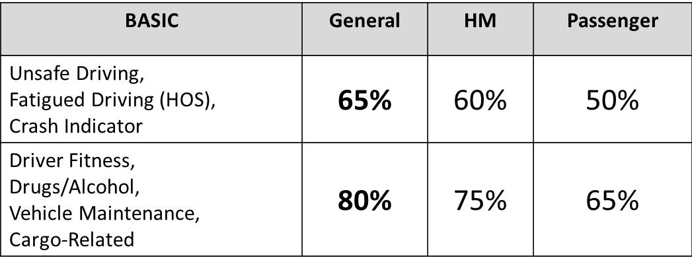
CSA Results – Effectively Identifying Safety Problems
FMCSA and independent analysis shows that the SMS is an effective tool for identifying high-risk motor carriers.
A particularly strong association exists between high percentile ranks in the Unsafe Driving and Fatigued Driving (Hours-of-Service) BASICs and crashes.
FMCSA optimizes resources through more stringent Intervention Thresholds for BASICs with the strongest associations to crash risk.
Notes:
The independent analysis was conducted by the University of Michigan’s Transportation Research Institute (UMTRI). Full results of their analysis can be found on the CSA Outreach Website.

Slide 7
CSA Results – Effectively Improving Safety Compliance and Performance
As of May 2012, FMCSA sent out more than 55,000 warning letters.
83% of carriers improved within 12 months of receiving a warning letter.
The SMS Website, which publicly displays the Agency’s workload prioritization, hosted nearly 30 million users in 2011, compared to nearly 4 million in the prior year.
In 2011, roadside inspection violation rates decreased by 8% and driver violation rates decreased by 10%.
This is the most dramatic improvement in violation rates in the last 10 years.
Notes:
7
The role of FMCSA not only encompasses safety but also ensuring compliance with the Federal Motor Carrier Safety Regulations (FMCSRs). The numbers on this slide show that compliance (and, therefore safety) is improving.

Slide 8
SMS Enhancements

Slide 9
SMS Improvement Process
SMS is designed and intended to be continually improved.
FMCSA has responded to feedback from industry, State Partners, and other stakeholders.
FMCSA will take a systematic and transparent approach to rolling out improvements.
Prioritize and package changes periodically.
Provide enforcement personnel and motor carriers a preview period prior to implementation.
Provides carriers an opportunity to review data, make improvements, and comment on enhancements.
First set of changes:
March – July 2012 preview of changes and formal comment period (extended 60 days from the original time frame);
Fall 2012 changes implemented into SMS.
Notes:
In making the workload prioritization methodology transparent to all FMCSA stakeholders, the Agency has encouraged and responded to feedback from industry, State Partners, safety advocates, etc. to ensure this compliance and enforcement program is as strong, fair, and accurate as possible.
9

Slide 10
SMS Proposed Changes
Motor carriers identified for interventions under the proposed methodology have a higher future crash rate and higher HM violation rate than the carriers identified under the current methodology.
Also, these identified carriers are involved in more crashes.
Notes:
All of the proposed changes will help FMCSA to more efficiently and effectively prioritize the Agency’s workload to focus on carriers that pose the highest risk to safety. Today, we are going to focus the presentation on three areas that we have received the most questions on. Those areas are:
Moving cargo securement violations into the Vehicle Maintenance BASIC
The new HM BASIC
The changes to the HM Threshold definition
(Excerpt from foundational document): Under the proposed approach, slightly fewer carriers will be identified for FMCSA intervention, but those carriers that are identified demonstrate higher crash involvement, as well as higher HM violation rates. Overall, these proposed changes will help FMCSA identify carriers for intervention that pose a higher safety risk, both in terms of future crash involvement and the potential for increased consequences resulting from the presence of HM if a crash occurs. As shown in the data below, motor carriers identified for interventions under the proposed SMS changes are shown to have a higher future crash rate and higher HM violation rate than the motor carriers identified under the current SMS Methodology.
10

Slide 11
SMS Proposed Changes
Strengthen the Vehicle Maintenance BASIC by incorporating cargo/load securement violations from the Cargo-Related BASIC.
Change the Cargo-Related BASIC to Hazardous Materials (HM) BASIC to better identify HM safety and compliance problems.
Better align SMS with Intermodal Equipment Provider (IEP) regulations.
Align violations included in SMS with CVSA inspection levels by eliminating vehicle violations derived from driver-only inspections and driver violations from vehicle-only inspections.

Slide 12
SMS Proposed Changes
More accurately identify carriers that transport significant quantities of HM.
More accurately identify carriers that are involved in transporting passengers.
Modify the SMS display to:
Change terminology (replace terms Insufficient Data and Inconclusive) to fact-based definitions.
Break out crashes with injuries and crashes with fatalities.

Slide 13
Move Cargo Securement Violations into the Vehicle Maintenance BASIC
Strengthen the Vehicle Maintenance BASIC by incorporating load securement violations from today’s Cargo-Related BASIC
Mitigates bias in the current Cargo-Related BASIC whereby flatbed operators are disproportionately identified for intervention.
Continues to identify motor carriers with systemic cargo securement compliance problems.
Makes Vehicle Maintenance BASIC more effective.
The Vehicle Maintenance BASIC will remain public.
Notes:
Strengthen the Vehicle Maintenance BASIC by incorporating the load securement violations that today are included in the Cargo-Related BASIC.
FMCSA continues to believe improperly secured cargo can pose serious safety threats.
FMCSA now identifies motor carriers with an inordinate number of load securement violations through the Cargo-Related BASIC.
Unfortunately, FMCSA information systems and roadside inspection data provided by the States does not distinguish between flatbed (open deck) trailers and closed van trailers. As a result, flatbed operators are subject to potential bias because their number of load securement violations per inspection are evaluated in comparison to operators that exclusively operate closed van trailers. Put simply, the current design of the Cargo-Related BASIC and information system limitations can lead to flatbed operators being falsely identified as having load securement problems. In fact, FMCSA analysis of a sample of flatbed operators found that over half of them had Cargo-Related BASIC percentile ranks worse than over 80% of the carriers they were compared against.
By moving load securement violations to the Vehicle Maintenance BASIC and recalibrating their weights, FMCSA has:
Mitigated the known bias created by information system limitations
Ensured those carriers with actual load securement violations are still identified
Strengthened the Vehicle Maintenance BASIC in terms of its association with future crash rates
FMCSA specifically examined the carriers identified above the Intervention Threshold (i.e., those in the 80th percentile) in the current Cargo-Related and Vehicle Maintenance BASICs and compared them to carriers identified under the proposed new Vehicle Maintenance BASIC. Carriers identified under the new Vehicle Maintenance BASIC had over a 20% higher crash rate.
Cargo securement violations comprise 82% of violations in the current Cargo-Related BASIC, when added to the Vehicle Maintenance BASIC, they comprise 4% of violations.
The proposed Vehicle Maintenance BASIC identifies carriers with higher crash risk compared to the current Cargo-Related BASIC.
The carriers identified under the proposed Vehicle Maintenance BASIC have a 40% higher crash rate.

Slide 14
New HM BASIC
Change the Cargo-Related BASIC to the HM BASIC
Removes load securement violations so that only HM violations remain.
Provides a more objective comparison with respect to HM compliance; consequences of crashes and cargo spills are increased when HM are involved.
Enables enforcement staff to better identify and address HM safety and compliance issues.
FMCSA intends to make the HM BASIC public; however, a final decision will be made at end of preview period.
Notes:
Changes to the Cargo-Related BASIC that enable SMS to better identify and address safety problems related to HM.
This change is being implemented because the consequences of crashes and cargo spills can be greatly exacerbated when HM are involved. Since, under the current system, HM is included along with load securement violations, some of those issues could be masked.
As a result, load securement violations will be removed from the Cargo-Related BASIC and placed in the Vehicle Maintenance BASIC. A new HM BASIC will be introduced that will be based on vehicle inspections (levels 1, 2, 5, and 6) and HM violations where the vehicle was transporting placardable quantities of HM. The Cargo-Related BASIC will no longer be used.
FMCSA consulted subject matter experts to identify and apply severity weightings to the 239 HM violations contained in the Cargo-Related BASIC and 112 additional HM safety-based violations attributable to the motor carrier. The Agency then conducted effectiveness testing to compare the Cargo-Related BASIC with a new BASIC containing only the HM violations to determine which better identified carriers with a high risk of HM safety problems. The analysis found that the new BASIC identified carriers with higher violation rates than the current Cargo-Related BASIC (see next slide).
This change will ultimately provide a more objective comparison with respect to HM compliance and will allow for better identification of safety issues with transporting these unique types of cargo.
The Agency plans to make the HM BASIC public , but a final decision on that will be made after the comment period ends and all of the feedback and suggestions from stakeholders have been analyzed.

Slide 15
New HM BASIC
Does the proposed HM BASIC identify HM risk better than the current Cargo-Related BASIC?
Effectiveness testing indicates the proposed HM BASIC results in a higher HM violation rate than the current Cargo-Related BASIC.
SMS Effectiveness Test Results (using 80% Threshold)
BASIC | HM Inspections | HM Violation Rate | HM Out-of-Service (OOS) Rate
Cargo-Related (current) | 37,675 | 29.08% | 4.03%
HM (proposed) | 36,188 | 33.75% | 5.42%
*for the entire population, the HM violation rate is 23% and the HM OOS rate is 3.4%.
Notes:
This chart shows that carriers that were identified as being above the Intervention Threshold (80%) in the proposed HM BASIC had higher HM violation rates and OOS rates than carriers that were identified as being above the Intervention Threshold in the current Cargo-Related BASIC.
The numbers were generated by running the two versions of SMS at a period of time (about 18 months ago) and then looking at the subsequent HM inspections that occurred (and outcomes of those inspections) for 18 months after the snapshot date.
This chart shows that the proposed HM BASIC captures carriers with higher future HM safety issues.

Slide 16
New HM Intervention Threshold
More effectively identify carriers involved in transporting HM
New Intervention Threshold definition:
At least 2 placardable HM inspections; 1 within past 12 months; and
At least 5% of total inspections indicated as placardable HM inspections.
The HM Intervention Threshold continues to apply to carriers with safety permits and to carriers indicated as “transporting placardable amounts of HM” on investigations.
More stringent Intervention Thresholds are applied to all BASICs except the proposed HM BASIC.
New definition will enable FMCSA to focus resources on carriers involved in the majority of placardable HM transport.
Notes:
More effectively identify motor carriers that are involved in transporting people or HM so that FMCSA can hold those carriers to a higher safety standard by applying more stringent Intervention Thresholds.
HM Intervention Threshold – This criteria has nothing to do with the HM BASIC. It is about all the OTHER BASICs. That is – Identifying which carriers should have 5 points less tolerance in the BASICs (e.g., 75 instead of 80 for Vehicle, 60 instead of 65 for Fatigued Driving (HOS))
In CSA, FMCSA applies more stringent SMS standards to carriers involved with hauling HM. In August 2011, the criteria used for identifying HM carriers was changed to any carrier with HM activity (HM Inspection, Review, or Permit) in the past two years, rather than prior criteria based strictly on the HM commodities hauled information, which was self-identification on the MCS-150.
Feedback from industry and enforcement on this change was that certain carriers identified under these new criteria rarely hauled or were mistakenly identified as hauling placardable amounts of HM.
FMCSA conducted an analysis to determine how many carriers would be subject to the HM Intervention Threshold if the Agency changed the inspection criteria to require the observation of recent inspections and a certain percentage of inspections where the carrier was designated as hauling placardable quantities of HM. FMCSA determined that tightening the HM placardable inspection criteria would exclude 11,432 of the approximately 24,000 carriers currently subject to HM Thresholds, yet would still cover a vast majority of the placardable HM activity (i.e., 94% of the total number of placardable HM inspections).
As a result, FMCSA will tighten the HM placardable inspection criteria to include:
- At least 2 HM placardable inspections, with 1 in the past 12 months.
- At least 5% of total inspections indicated as HM placardable inspections.
This solution would weed out carriers with only minor numbers of placardable HM inspections and allow FMCSA and our State Partners to focus on carriers involved in the majority of placardable HM transport.

Slide 17
HM BASIC vs. HM Intervention Threshold
Proposed HM BASIC – measures violations cited on inspections where carriers have placardable amounts of HM.
Must have at least 5 vehicle inspections with placardable amounts of HM and at least 1 HM violation.
Used to identify carriers with safety problems in carrying HM to be prioritized for investigations.
Proposed HM Intervention Threshold – set for carriers that carry HM as a significant part of their business.
Must have 2+ HM placarded inspections in the last 24 months with one in the last 12 months and at least 5% of total inspections must be HM.
Used to identify HM carriers that are subject to the more stringent Intervention Thresholds in all of the BASICs (except HM) to be prioritized for investigations.

Slide 18
SMS Preview Website

Slide 19
SMS Preview
SMS Preview displays how each carrier’s SMS results will change when the pending improvements are implemented in SMS
Only logged-in motor carriers and enforcement personnel have access.
The SMS Preview Website looks different than the SMS Website and it’s important distinguish between the two for users:
SMS look and feel will not change; it will just be updated to reflect the improvements discussed in this presentation.
The SMS Preview Website explains and specifically identifies changes that will become part of SMS upon implementation.
Feedback is encouraged.
Notes:
It’s important to distinguish between the SMS Preview Website and the SMS Website. The SMS Preview Website shows how impending SMS changes and improvements will affect individual motor carriers’ scores and percentiles; it specifically calls attention to the changes in order to orient users with what will be implemented into SMS. It is used for FMCSA workload prioritization.
The SMS Preview Website is only available to logged-in motor carriers and enforcement personnel. Shippers/Insurers and the public do not see the SMS Preview.

Slide 20
Accessing SMS Preview
Notes:
Log in to the Portal and select the CSA Outreach link.
20

Slide 21
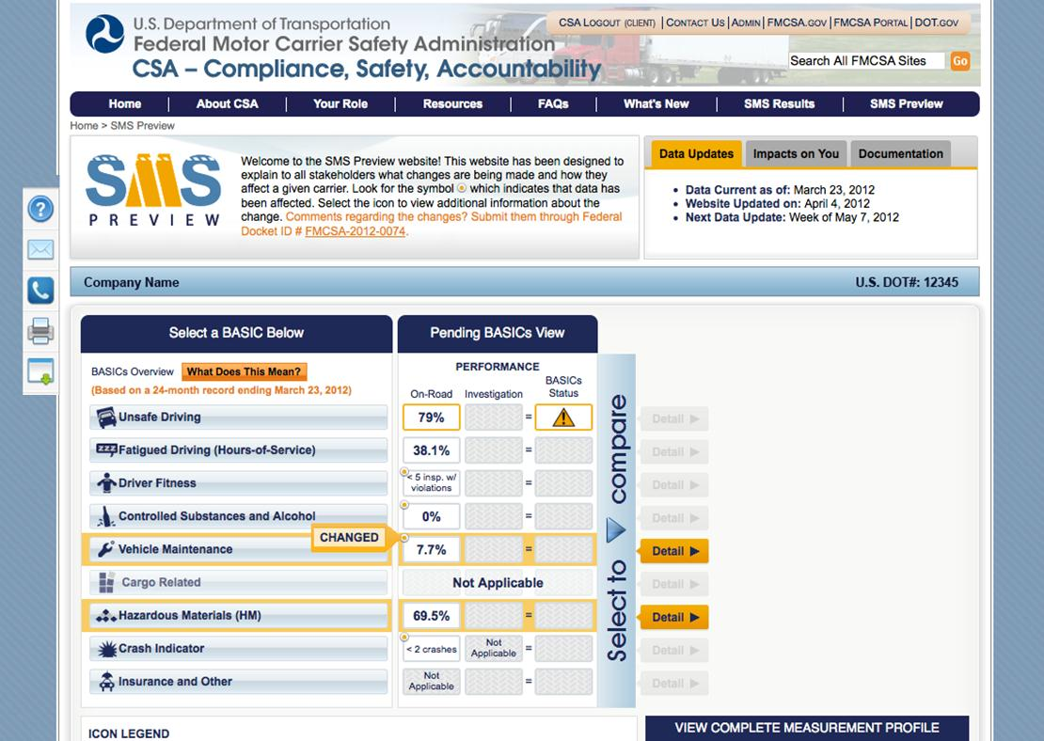
Notes:
This page shows the Carrier Overview (similar to today’s SMS Website) with additional features:
(CLICK MOUSE)
This area lists when the SMS data was last updated and the next anticipated update date (both of which were frequent questions during the 2010 data review/preview).
The “Impacts on You” tab contains a customized list of updates by U.S. DOT #.
The “Documentation” tab contains links to related collateral material.
(CLICK MOUSE)
This toolbar is on the left side of every webpage and scrolls down the page with the user so it is always available. It provides quick access to the Help Center, Contact Us email form, Division phone and CSA 1-800 numbers, print feature, and data download center.
(CLICK MOUSE)
The initial view only shows the pending information. Users can click on the blue arrow (in the “Select to Compare” section) to expand the page to include current data (see next slide).

Slide 22
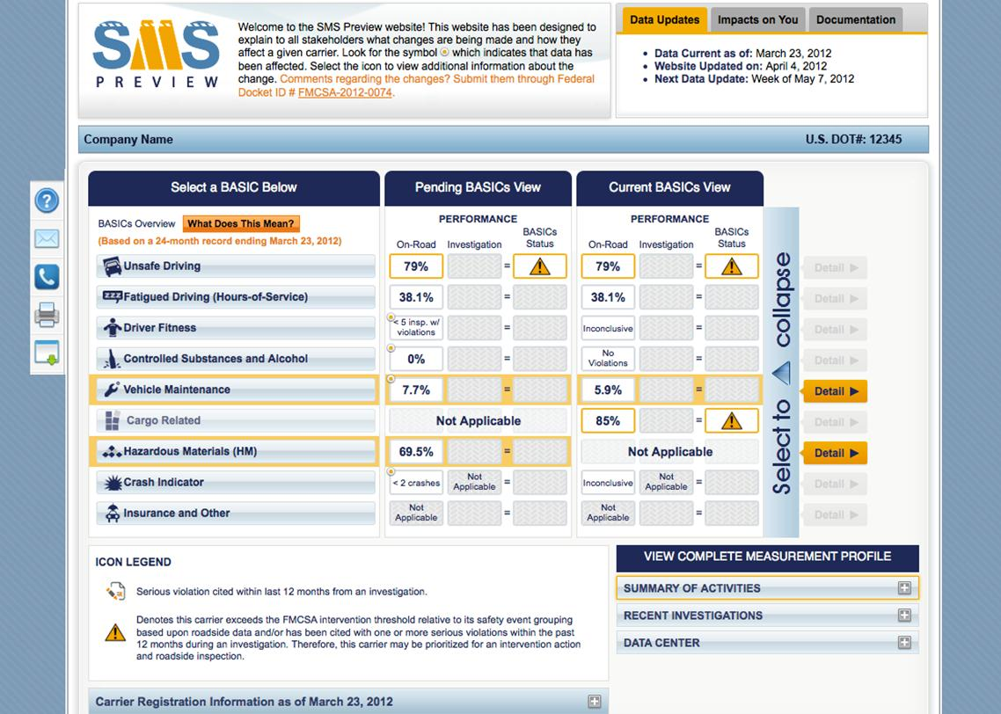
Notes:
After clicking on the blue arrow, users are able to see the Carrier Overview page with the current and pending information shown side-by-side for comparative purposes.

Slide 23
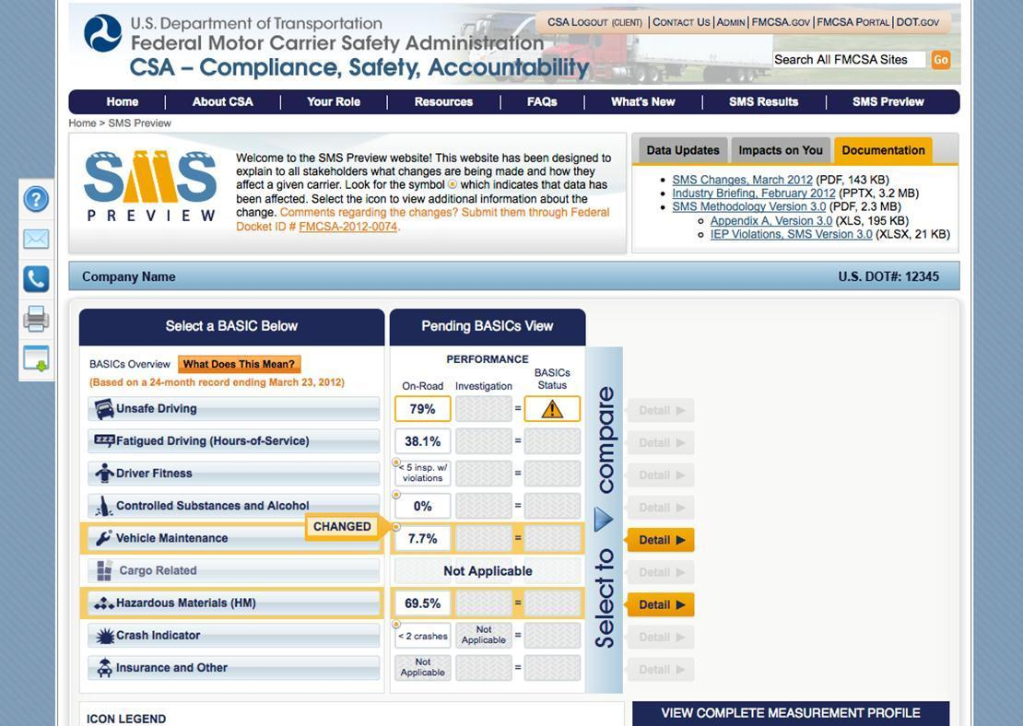
Notes:
Back on the Carrier Overview page, users can click the “What Does This Mean?” button to get a better understanding and description of what each of their BASIC percentages are indicating (as seen on the next slide).

Slide 24
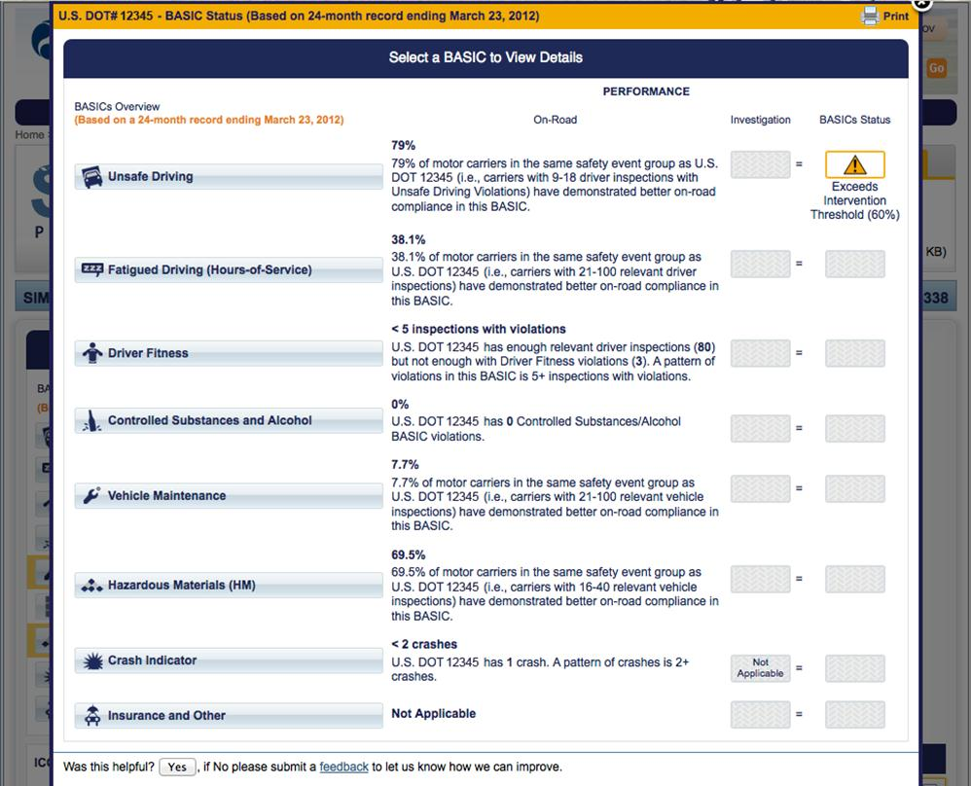
Notes:
This screenshot shows a detailed explanation of what the values for each BASIC mean to a carrier.
(CLICK MOUSE)
This is a highlighted view of the explanation for the Unsafe Driving BASIC showing what, exactly, the “79%” means to the carrier.

Slide 25
Notes:
This screenshot shows the overview of a carrier’s pending SMS information with an arrow pointing to the “Changed” icon with a yellow circle. In addition to highlighting areas that are affected by a change, the yellow dot appears next to changed data. When the user hovers over the dot, it will display the “Changed” tag, which will lead a user to an additional explanation.

Slide 26
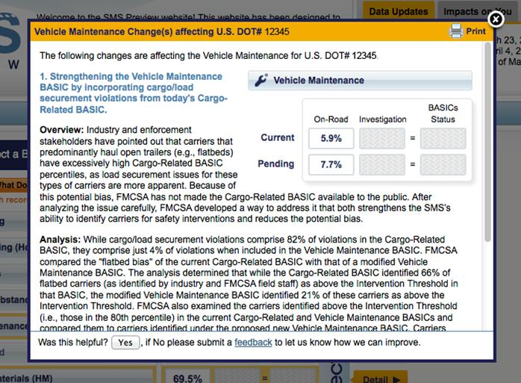
Notes:
Details pop up when a user selects a yellow highlighted circle. The pop-up explains the change, shows the carrier its current and pending data, and includes direct links to related questions such as why the change was made.

Slide 27
Notes:
As with SMS today, users can get more detailed information for each BASIC by clicking on the name of the BASIC. The detailed BASIC page contains all of the same information as SMS; any new items (i.e., new violations) will be indicated with the same yellow dot that you see on the homepage. A user can click on the yellow dots for an explanation of the change/improvement.

Slide 28
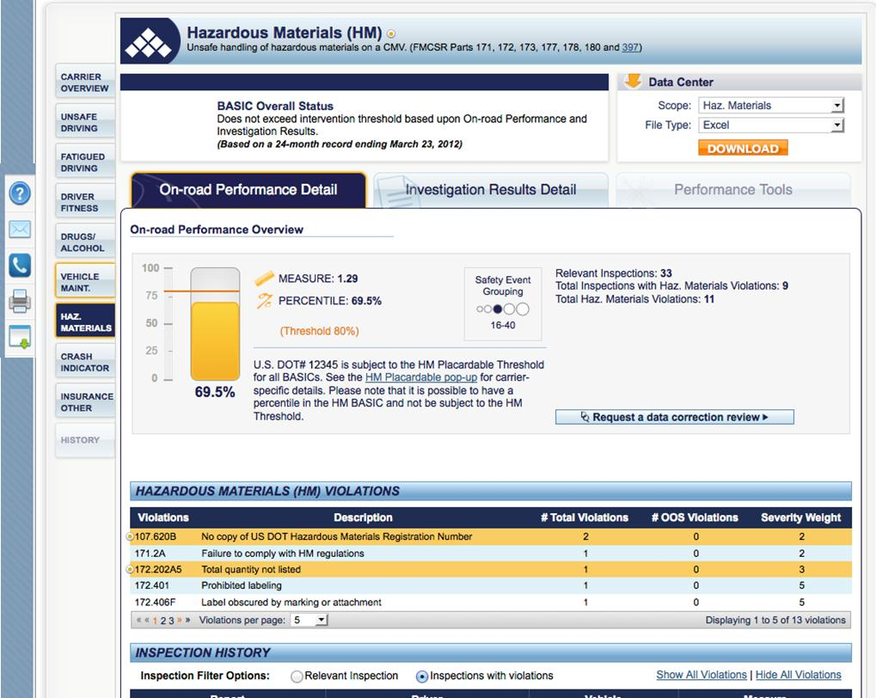
Notes:
This page shows what a detailed BASICs page will look like. The layout is very similar to the current SMS Website. Areas that have changed are highlighted with a yellow border.
CSA yellow highlights indicate items that are added to the BASIC. Lighter yellow indicates rows or items that have been deleted. The slide shows arrows pointing out the yellow dots that users should pay attention to.
The next screenshot will show the bottom half of this page, which is the Inspection History for the carrier.

Slide 29
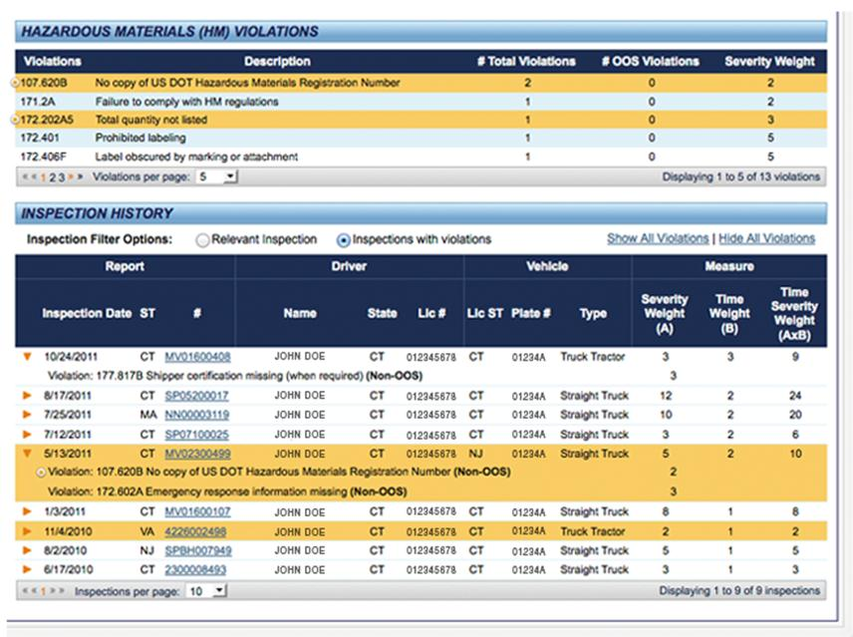
Notes:
This slide shows the bottom half of the BASIC details tab. Included here is the Inspection History of the carrier; to view violations cited during a specific inspection, users can click the arrow on the left next to the corresponding inspection.
Again, proposed changes are highlighted in yellow.

Slide 30
What Should Motor Carriers Do During the SMS Preview Period?
Log in to the CSA Website to view the SMS Preview and understand how Package 1 enhancements will affect them.
Review trends and patterns and take action to improve safety compliance.
Request a review of data that may not be accurate at the DataQs Website at https://dataqs.fmcsa.dot.gov/login.asp.
Provide feedback by submitting comments to the Docket; go to www.regulations.gov and type in Docket Number FMCSA-2012-0074 (the link to the Docket is provided at the top of the SMS Preview).
FMCSA will collect, assess, and address feedback during the SMS Preview and may further refine enhancements before release.

Slide 31
FAQs

Slide 32
FAQs
Are only a small number of carriers measured through SMS?
No. SMS has sufficient data to assess 200,000 carriers (of the 525,000 carriers with activity within the past three years). They account for 92% of crashes.
Is CSA specifically targeting small carriers?
No. SMS identifies the same number of small carriers as the previous SafeStat system and a proportionate number of small, medium, and large carriers for interventions.
How closely is the HM BASIC tied to crash risk?
The goal of the HM BASIC is not to predict future crash risk. It is to be an indicator of a motor carrier’s ability to properly package, transport, and accurately identify and communicate hazardous cargo in the event of a crash or spill.

Slide 33
FAQs
Why are the load securement violations being moved to the Vehicle Maintenance BASIC and not the Unsafe Driving BASIC?
The Vehicle Maintenance BASIC is focused on the physical condition of the truck, of which the cargo is a part, whereas the Unsafe Driving BASIC is focused on how the vehicle is being driven (e.g., improper lane change, speeding).
Also, the Vehicle Maintenance BASIC is normalized by number of inspections whereas the Unsafe Driving BASIC is normalized by on-road exposure measured by Power Units and Vehicle Miles Traveled (VMT).
Does the proposed HM BASIC place a greater emphasis on HM paperwork violations and less on cargo securement violations?
No. The severity weights in the HM BASIC place an emphasis on performance-related violations, such as HM spillage and proper securement, and less so on violations related to shipping papers.
Notes:
Load securement violations are best normalized by the number of inspections (when the inspector is actually looking at the cargo).

Slide 34
FAQs
Is it possible to have a high percentile rank in the HM BASIC but not be subject to the HM Intervention Threshold in other BASICs?
Yes, a carrier’s HM BASIC can be above the Intervention Threshold without that carrier being subject to the HM Intervention Threshold in other BASICs. This situation could occur if a carrier has a lot of HM violations per inspection but less than 5% of its overall inspections involved placardable quantities of HM.
For example, a carrier has 7 inspections with placardable amounts of HM and each of those inspections has multiple HM violations. However, the carrier has 200 inspections in total over the past 24 months.
Since the inspections with placardable HM are less than 5% of all of the carrier’s inspections, it would not be subject to the HM Intervention Threshold, but could have an HM BASIC percentile because the data sufficiency standards are met.

Slide 35
FAQs
Why is my HM BASIC percentile high when all of my other BASIC percentiles are below the thresholds?
Each BASIC measures a different area of performance and compliance. Substantial compliance and good performance in the other BASICs doesn’t necessarily translate into compliance in the new HM BASIC.
In general, FMCSA has observed that motor carriers that infrequently transport placardable quantities of HM are not performing as well in the HM BASIC as motor carriers that transport placardable quantities as a routine part of their business. Additionally, FMCSA effectiveness testing of the new HM BASIC is showing a strong association between poor performance and future HM violation rates.

Slide 36
FAQs
Why are crashes that are not the fault of the truck driver used in the Crash Indicator in SMS?
Currently, all FMCSA-reportable crashes are used for the Crash Indicator.
Analysis conducted indicates that crash involvement (regardless of accountability) is a good predictor of future crash risk.
Notes:
The FMCSA’s SMS is a core component of the Agency’s compliance and enforcement programs. The SMS is designed to help the Agency prioritize its limited resources to have the greatest impact on large truck and bus crashes, injuries, and fatalities.
Recent analysis has demonstrated that SMS is an effective tool in identifying those carriers likely to have crashes. Of the 525,000 active carriers in FMCSA’s system, SMS identifies 200,000 carriers that have sufficient data to be assessed in at least one BASIC. These 200,000 carriers represent 92% of crashes. Of these 200,000 carriers, 94,000 carriers have enough negative information to have a percentile assigned, and those carriers are involved in 83% of the crashes.
FMCSA determines carrier role in crashes as part of compliance reviews before assigning an adverse safety rating. Put simply, motor carriers do not receive less than Satisfactory safety ratings unless the carrier’s role in their crash(es) is considered.
Separate from the safety rating process, FMSCA receives approximately 100,000 crash reports from the States each year. These crash reports do not include a determination of the carrier’s role in the crash when they are uploaded to FMCSA. However, analysis indicates that crash involvement (regardless of a carrier’s role) is a good predictor of future crash risk.
Therefore, FMSCA currently uses all of these crashes in the non-public SMS Crash Indicator to prioritize motor carriers for interventions.
However, in response to stakeholder interest and the Agency’s interest in continuously improving SMS, FMCSA looked into the feasibility of weighting crashes in SMS differently depending on the role of the carrier in those crashes. FMCSA recently released an analysis that assessed the feasibility of using Police Accident Reports (PARs) in determining a motor carrier’s role in crashes. This was a limited study that constitutes a first step in the Agency’s effort to address this issue. After initial discussions with the Agency’s stakeholders, FMCSA decided further study was needed before releasing a proposal for comment. There were several areas of concern, including the use of only PARs to make the determination, and the process for public input into the decision making process.
The Agency’s next step is to build on this study and conduct a comprehensive analysis into whether or not the carrier’s role in the crash is a better indicator of future crash risk. If so, then the Agency needs to determine the impact of assigning different severity weights to crashes depending on the carrier’s role in that crash. The key steps in this process are as follows: A broad study of PARs across the Nation will attempt to determine whether they provide sufficient, consistent, and reliable information that can be used to determine the carrier’s role in a crash. Analysis will be conducted to determine if the carrier’s role in the crash is a better indicator of future crash risk. If so, the analysis will determine the impact of weighting crashes differently in SMS.
Throughout this analysis, research will be reviewed from similar programs in other countries (e.g., Canada) to understand their analysis, processes, and applicability to SMS. Based on the results of this study, which will be available in the summer of 2013, further consideration of a proposal will be given.
SMS was designed to be continually improved as better data, information, and analysis become available. This Crash Weighting analysis project is a next step in that continuous improvement effort and will be evaluated to determine if the role of carriers in crashes is additional data that will improve the effectiveness of the measurement system.

Slide 37
FAQs
What regulation changes does CSA bring?
CSA has not changed any of the Federal Motor Carrier Safety Regulations (FMCSRs).
CSA has only changed how FMCSA operates in enforcing the FMCSRs that already exist.
In the future, FMCSA will consider a new methodology for determining the safety fitness of motor carriers. Such potential changes will be carried out through formal notice and comment rulemaking.

Slide 38
FAQs
What kind of changes to SMS are being considered for the next round of proposed improvements?
SMS is designed to be continually improved. Some of the enhancements being considered for proposal, preview, and comment in the next package include:
Comprehensive modifications to roadside violation severity weights
Recalibration of the Utilization Factor used to incorporate VMT for the Crash and Unsafe Driving BASICs
Adjustment to safety event groupings in all BASICs

Slide 39
For more information regarding CSA in general:
http://csa.fmcsa.dot.gov
For more information regarding the proposed SMS enhancements discussed today:
https://csa.fmcsa.dot.gov/Documents/SMS_FoundationalDoc_Final.pdf

